Slide 1
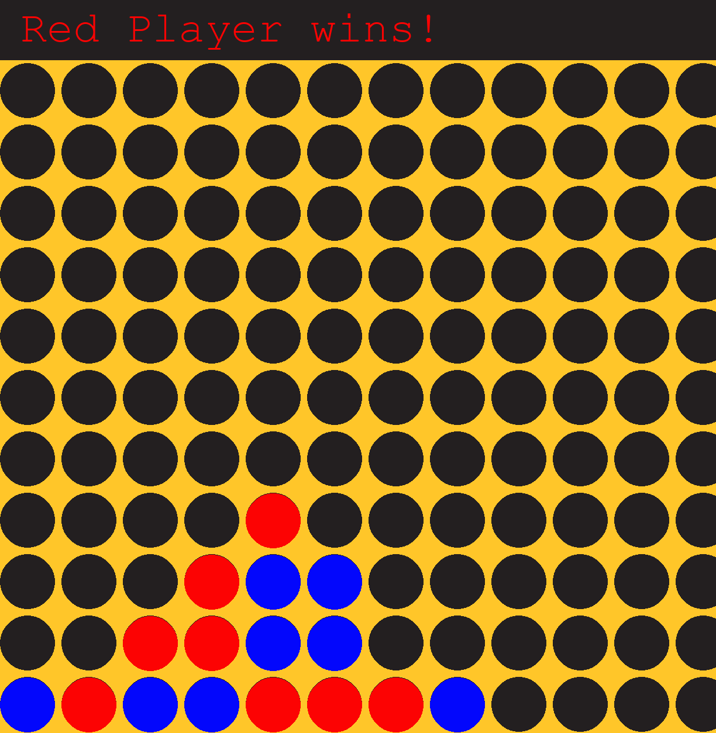
Connect 4 Python Game Matthew Lane
This game of Connect 4 allows two players to compete against each other in a race to Connect 4 pieces in either a diagonal, horizontal, or vertical formation!

Slide 2
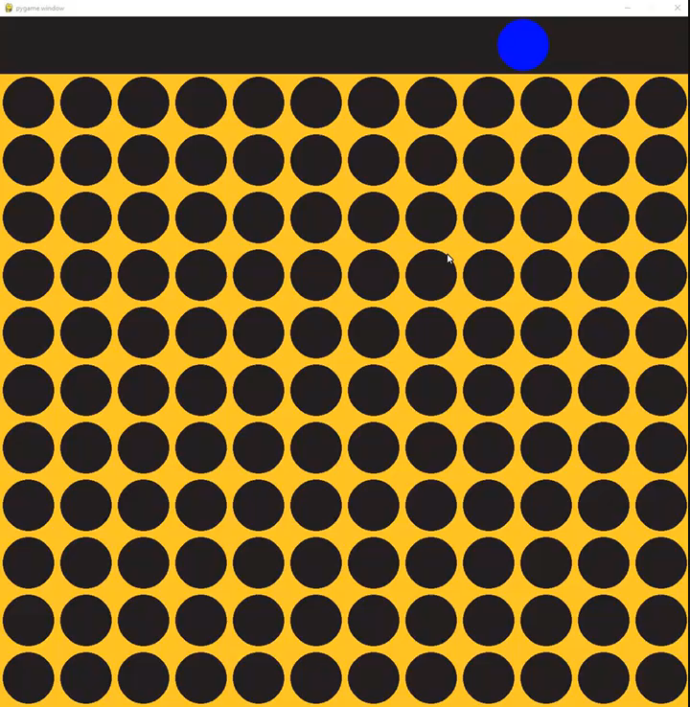
Animation
I added animations to the game to make it appear more life like!

Slide 3

Thanks for Stopping By!

