Slide 1
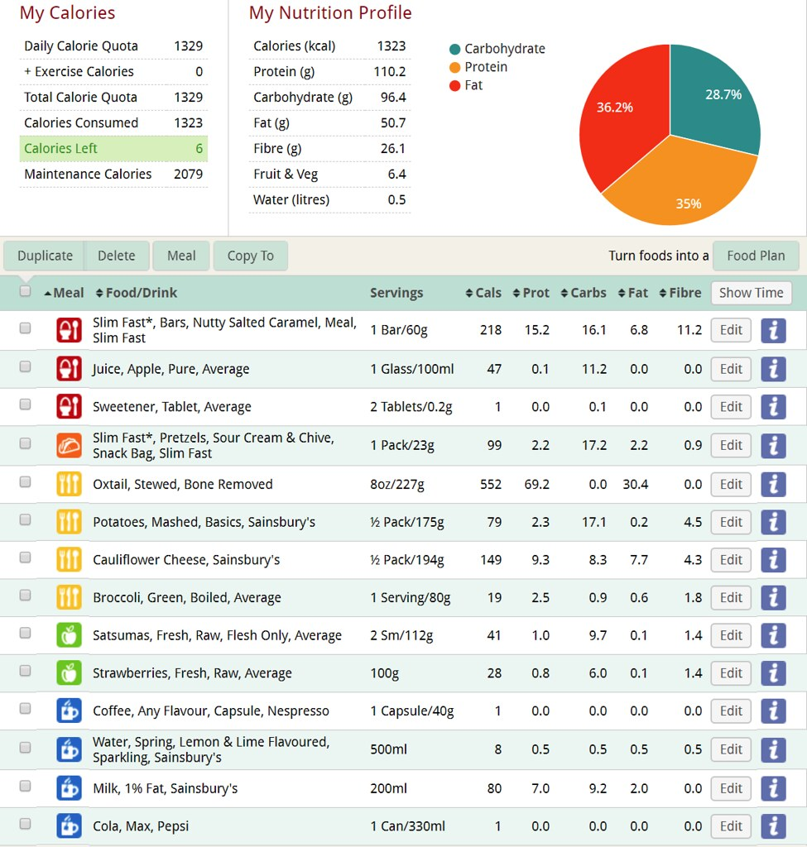
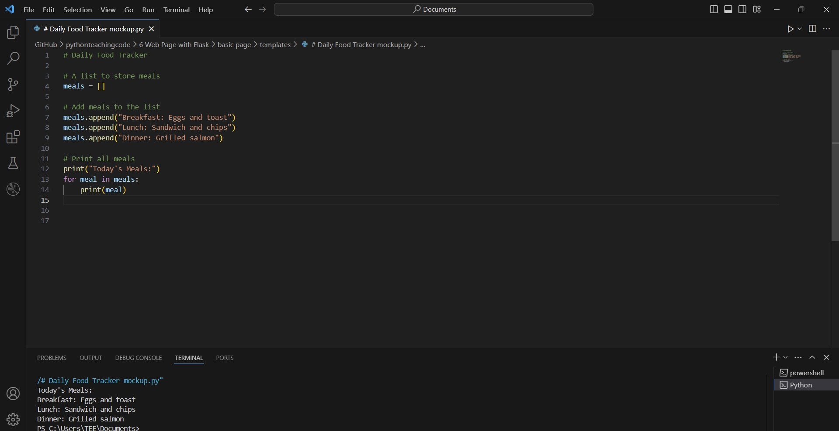
Daily Food Tracker
Simplifying Meal Tracking for a Healthier You
Team Members: Al-Ameen Omitogun
Repository :
https://github.com/ksu-is/Daily-Food-Tracker
A simple Python program to help users log their daily meals and monitor their eating habits. The app allows users to categorize their meals (e.g., breakfast, lunch, dinner, or snacks), view their meal history, and track basic statistics, such as the number of meals consumed over time. It's designed for anyone looking to improve their diet, stay mindful of their food choices, or track their nutrition in a user-friendly way

