Slide 1

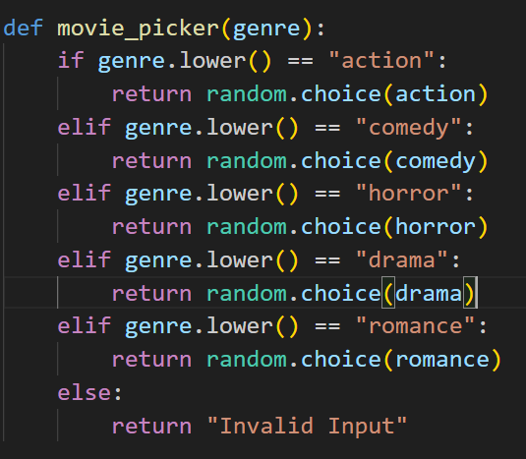
Movie Generator
This program takes a movie genre from user input and generates a random movie from that genre.
How does it work?
What does it do?
The program runs the user input through a set of if statements until is matches a genre. It then chooses a random movie from the list associated with the matched genre.
Sample Output
If Statements
Created by Dan Oren

