Slide 1
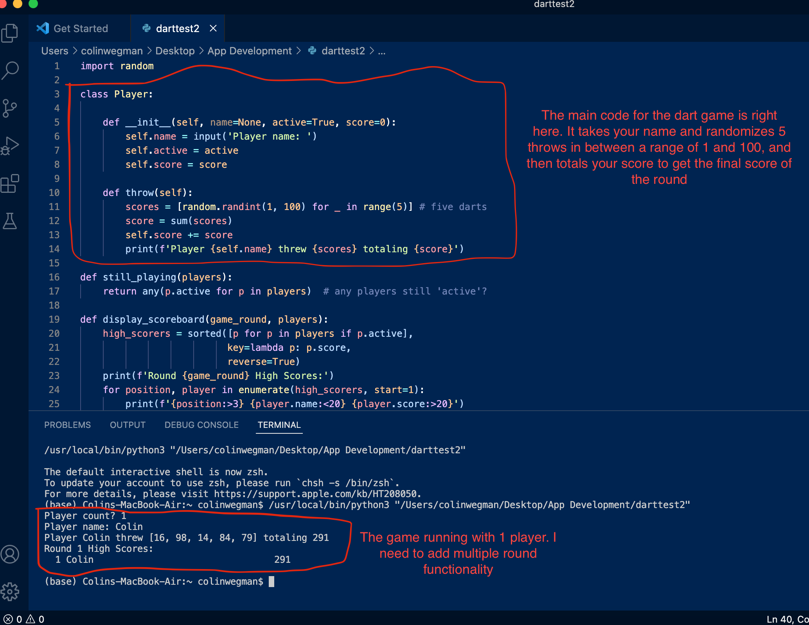
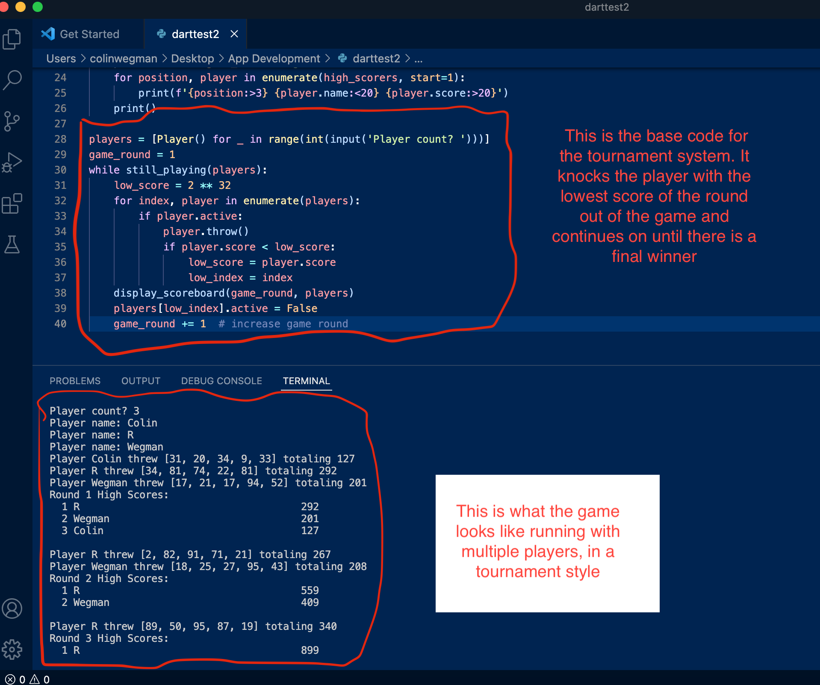
Colin Wegman: Dart Game
A Python text-based dart game with multiple players and a tournament mode

