Slide 1
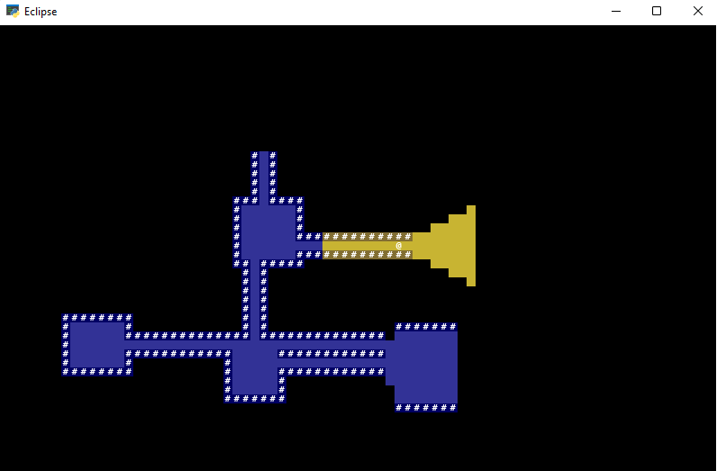
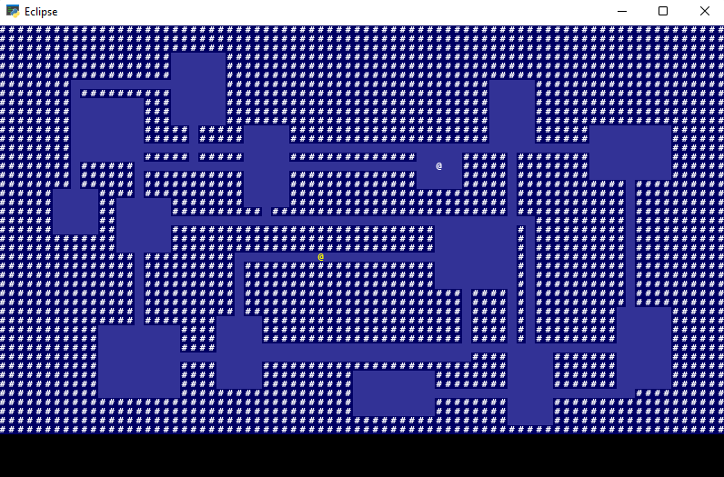
Eclipse
A 2D, procedurally generated dungeon crawler roguelike. Inspired by 1980’s “Rogue”, explore dungeons, slay monsters, get the loot!
By: Dartanian Pagel - https://github.com/ksu-is/Eclipse_Roguelike

