Slide 1
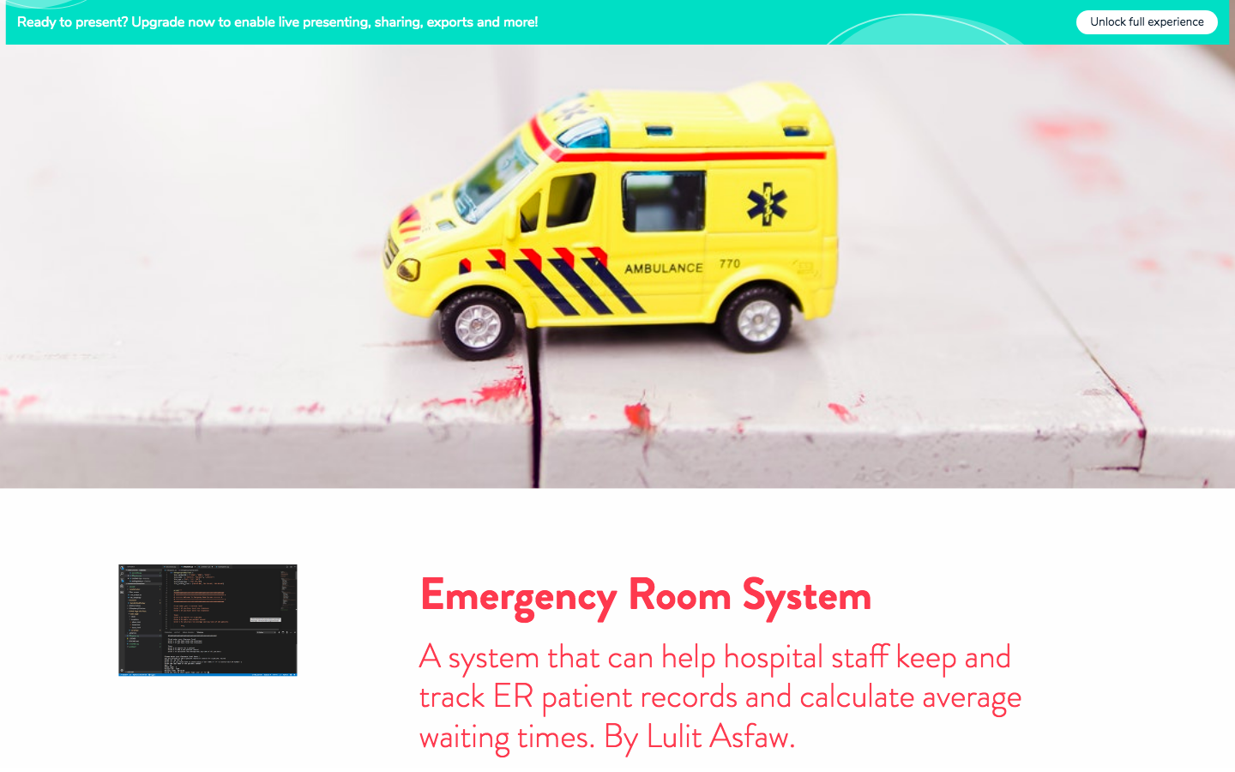
My Repository: https://github.com/ksu-is/Emergency-Room-System/blob/master/ERsystem.py
Similar source: https://github.com/sudipsingh04/Student-Record-System/blob/master/Program.py

