Slide 1

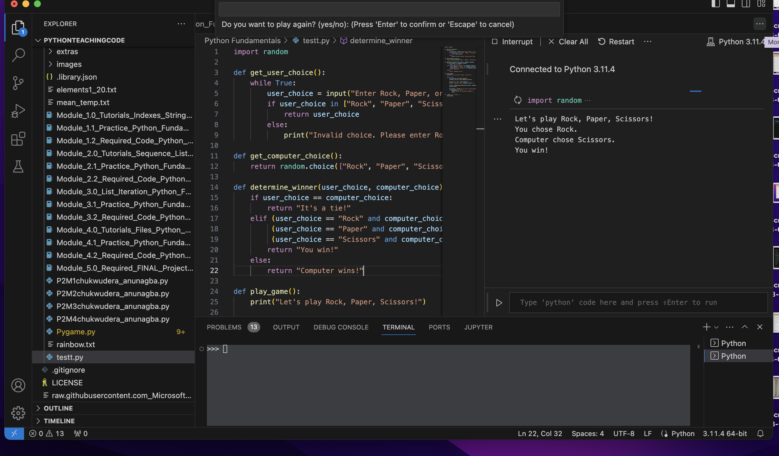
Enhanced Rock Paper Scissors
Presenter Name: Chukwudera Anunagba
Defeat the computer by strategically choosing between Rock, Paper, and Scissors. Anticipate the computer's moves and outsmart it to emerge victorious.
Be mindful of the game's simple rules, and adapt your choices to claim the title of the ultimate Rock, Paper, Scissors champion.
Have fun mastering the art of prediction and decision-making in this classic and timeless game!

