Slide 1

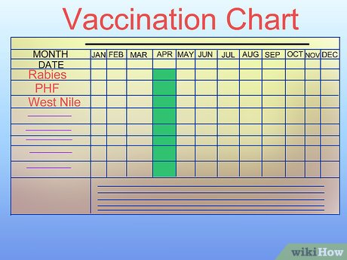
EquiTrack
By: Jessica Johnson
This app was designed to keep track of all equine vaccines. Within this app, horse owners will enter data to create a lengthy record over time of all vaccinations and the date they were given at the touch of a button! Essentially, it would take the information from the chart on the right and connect it with the horse and owner.

