Slide 1
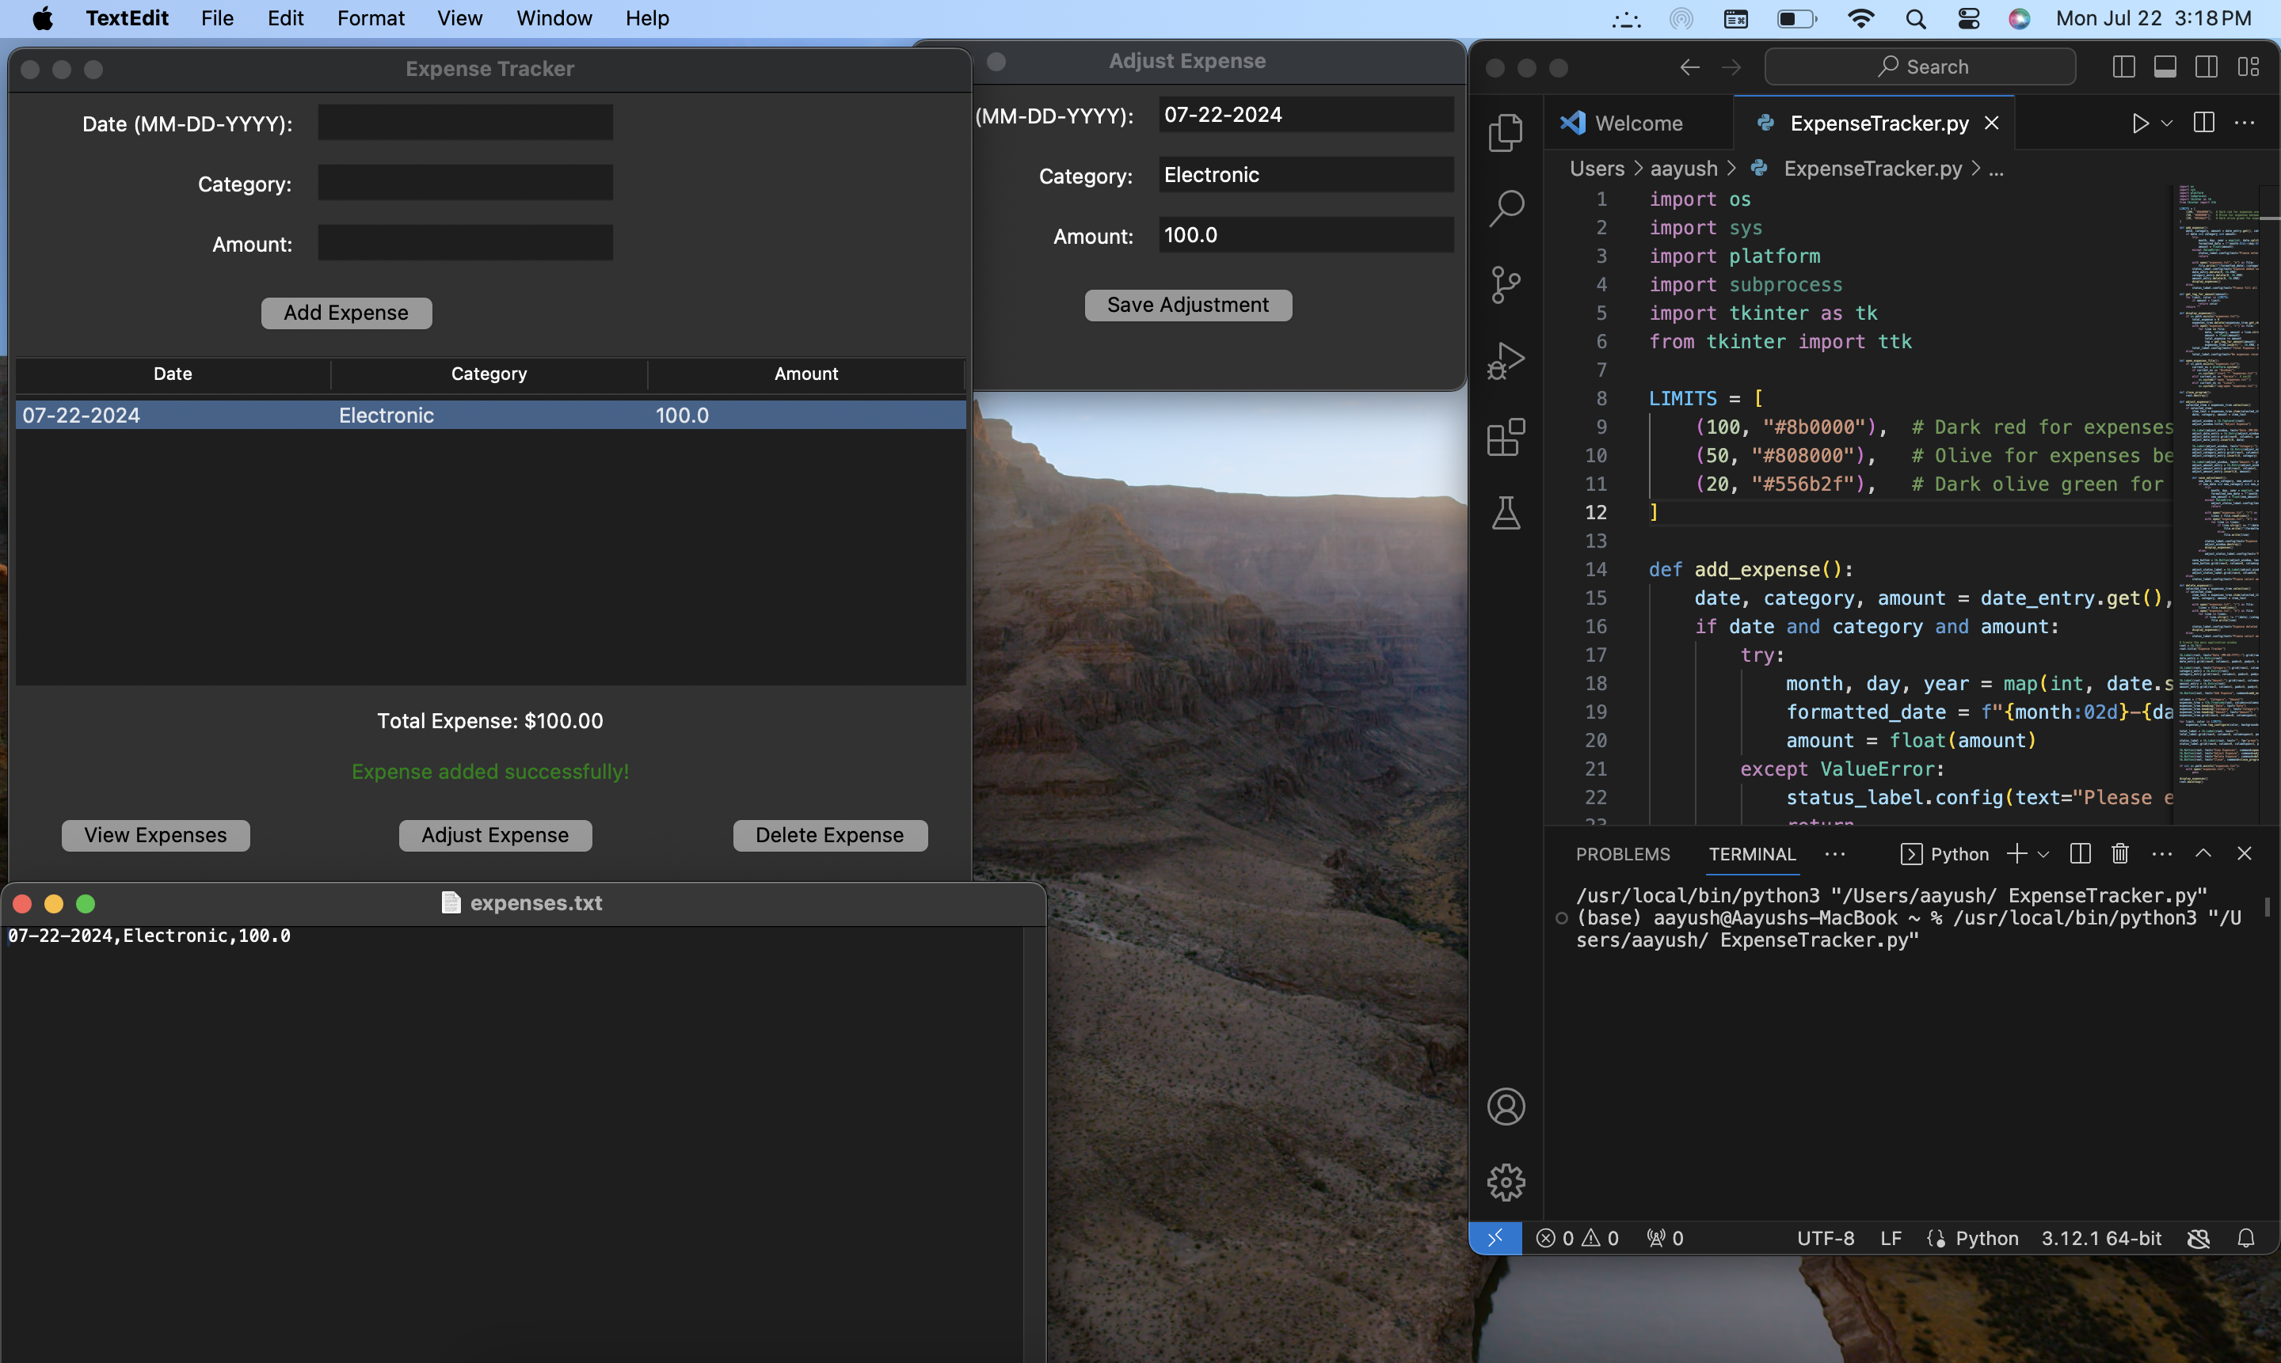
Expense Tracker. By: Aayush Patel
Part:3 To adjust the expense select the expense needs to be adjusted and adjust the expense
Part:1 enter date, category and amount
Track and Manage your Expenses in one place
This Expense Tracker application is designed to help users manage their expenses by providing a simple and intuitive interface for adding, viewing, adjusting, and deleting expense records. It uses file handling to store the expenses persistently and Tkinter for the graphical user interface, making it a practical tool for personal finance management.
How It works:
The application starts and checks if the expenses.txt file exists. If not, it creates an empty file.
The display_expenses() function is called to read any existing expenses from the file and display them in the Treeview widget.
The user interacts with the application by entering details into the input fields and clicking buttons to add, adjust, or delete expenses.
The application provides visual feedback and updates the displayed expenses based on user actions.
Part:2 To open this expense.txt file click on view expenses
Part:4 To delete expense click on delete expense and it will delete expense from file and window

