Slide 1
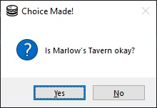
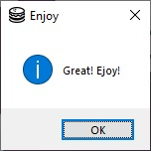
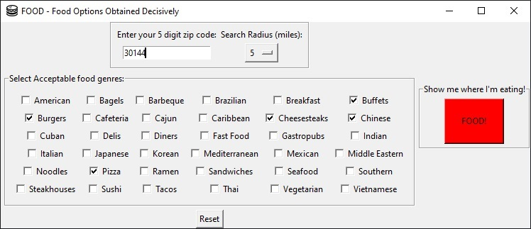
F.O.O.D
Food Options Obtained Decisively
Everyone dreads that point in the day when it is time to decide where to eat. FOOD makes short work of arguments that could drag on for hours. Simply feed the FOOD system your zip code, select your favorite (or at least acceptable) food genres and hit the Big Red Button ™. It will randomly decide for you where you are going to eat. But yes, for the truly indecisive, you can always refuse the choice, and make it pick again.
By Sam Davis

