Slide 2

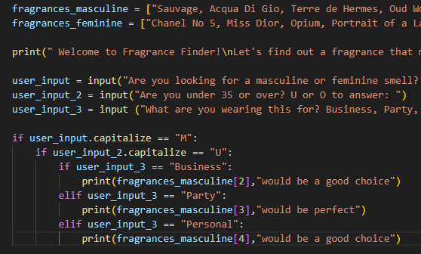
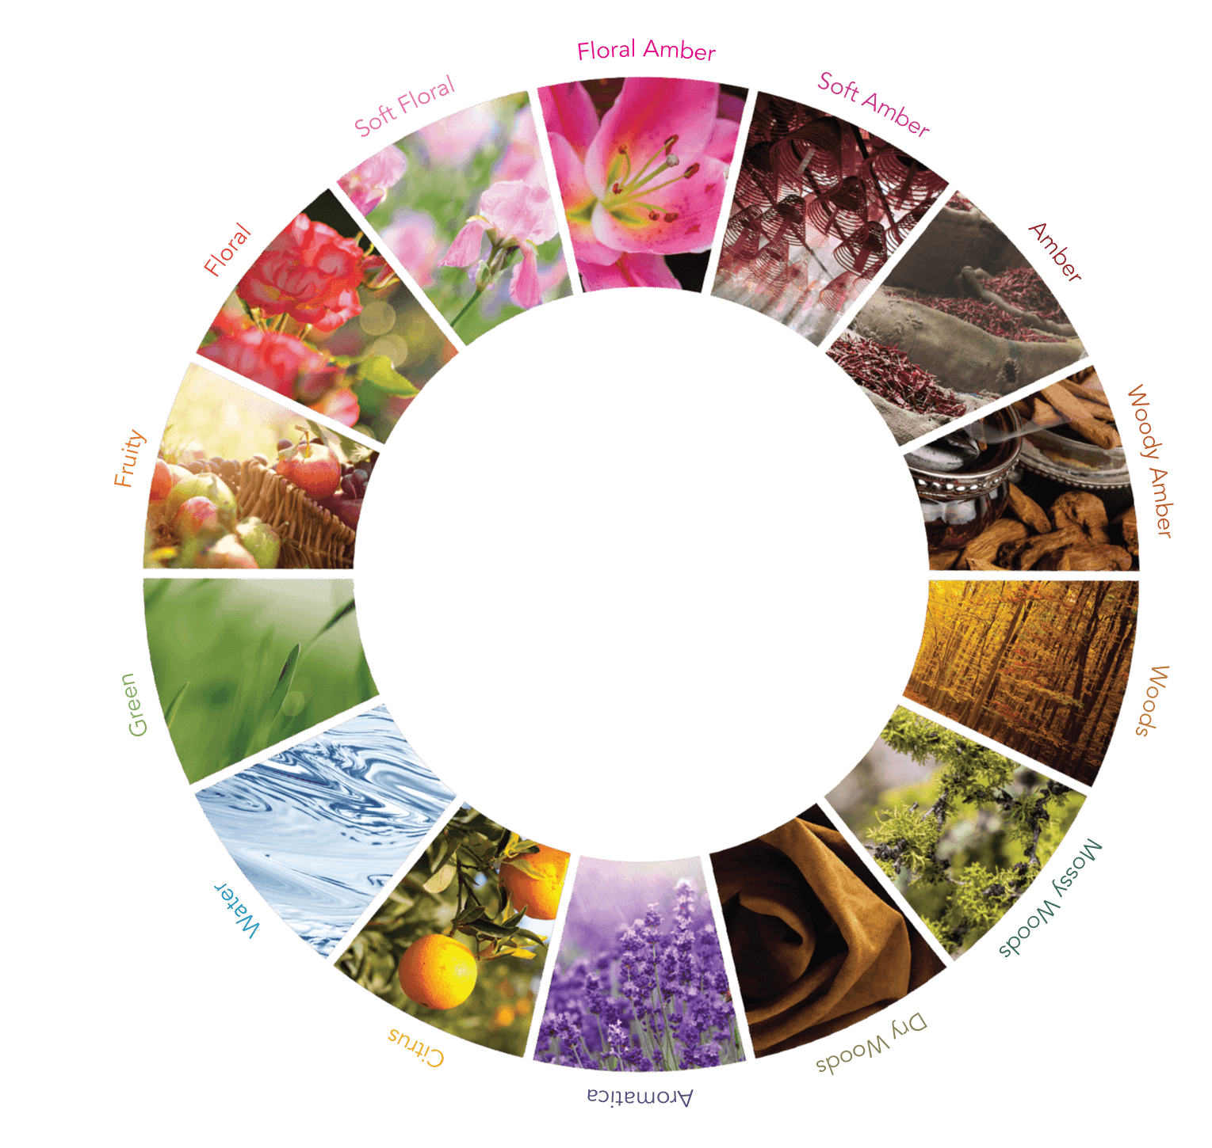
Fragrance Finder
Created by: Landon Kelly
Fragrance Finder is a program that I have created for like-minded people who love to smell good along with their amazing features. This system works by giving the user a series of questions to narrow down their preferences based on personality, style, season, and age. The fragrances are accessed from a list that I have created, which contains the most prominent smells on the market.
https://github.com/ksu-is/FragranceFinder

