Slide 1
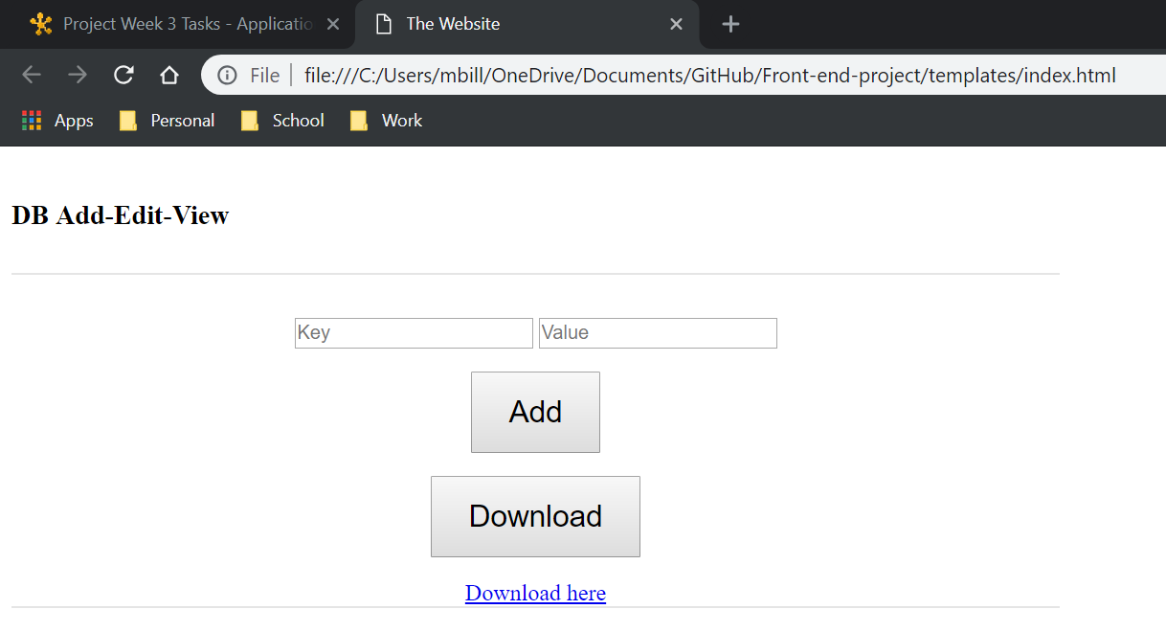
Website for updating gradebook database
Our goal is to create a website to enter student grades for all classes a student has so they can track their grades and calculate averages.asdfasdf
Project Members:
Billy Mitchell
Andrew Mitchell

