Slide 1
NOTICE!
I have a speech delay, which causes me to speak at a slow pace, and makes it difficult for others to understand what I’m saying. Therefore, I have pre-recorded what I would say on each side, except the Live Demo slide, and increased the speed, so that it will be easier to understand.
For the Live Demo, please bare with me, as I will have difficulty speaking while demonstrating the program.

Slide 2
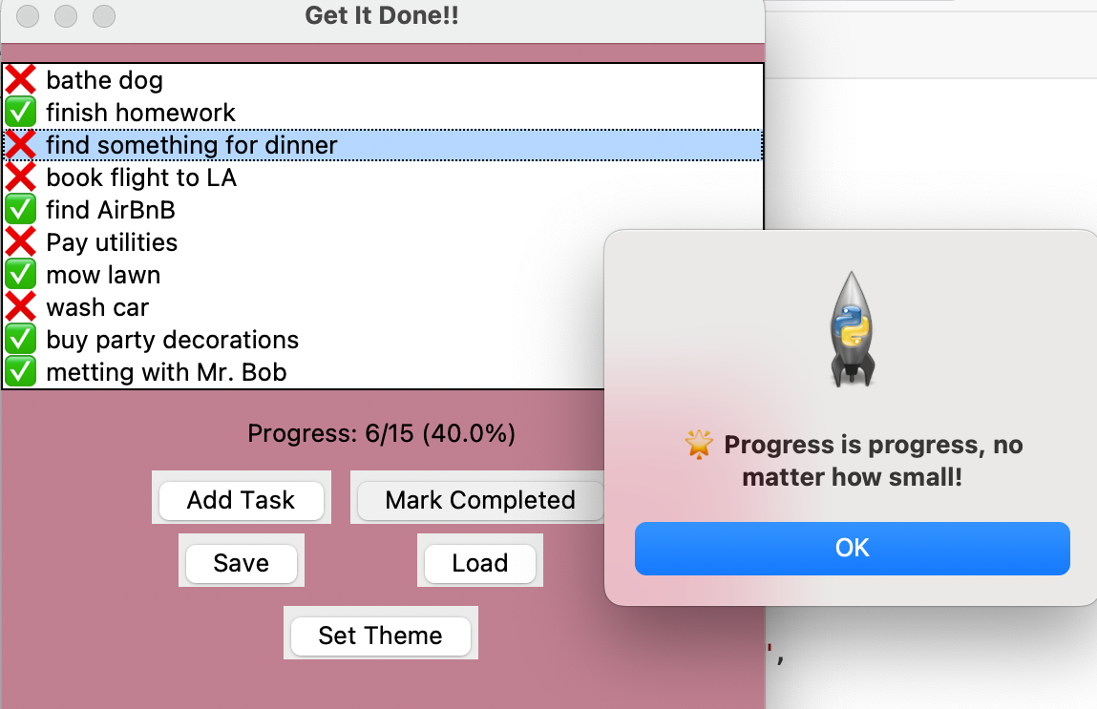
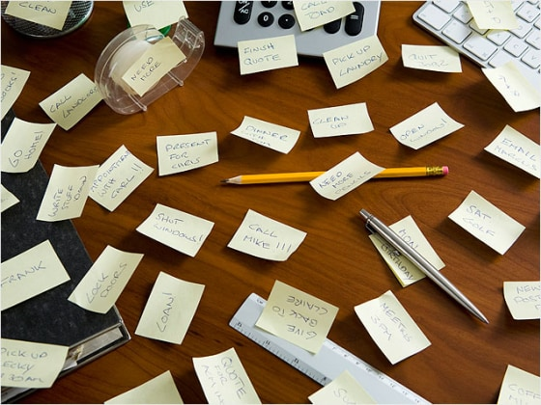
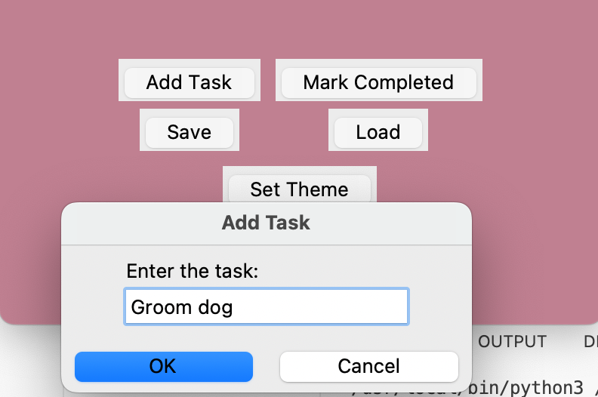

"Get It Done!! – Motivate Your Mind, Manage Your Time" (Helps users stay motivated and productive by tracking tasks and progress with encouragement.)
Brianna Jackson
https://github.com/ksu-is/Get_It_Done/tree/main

Slide 3
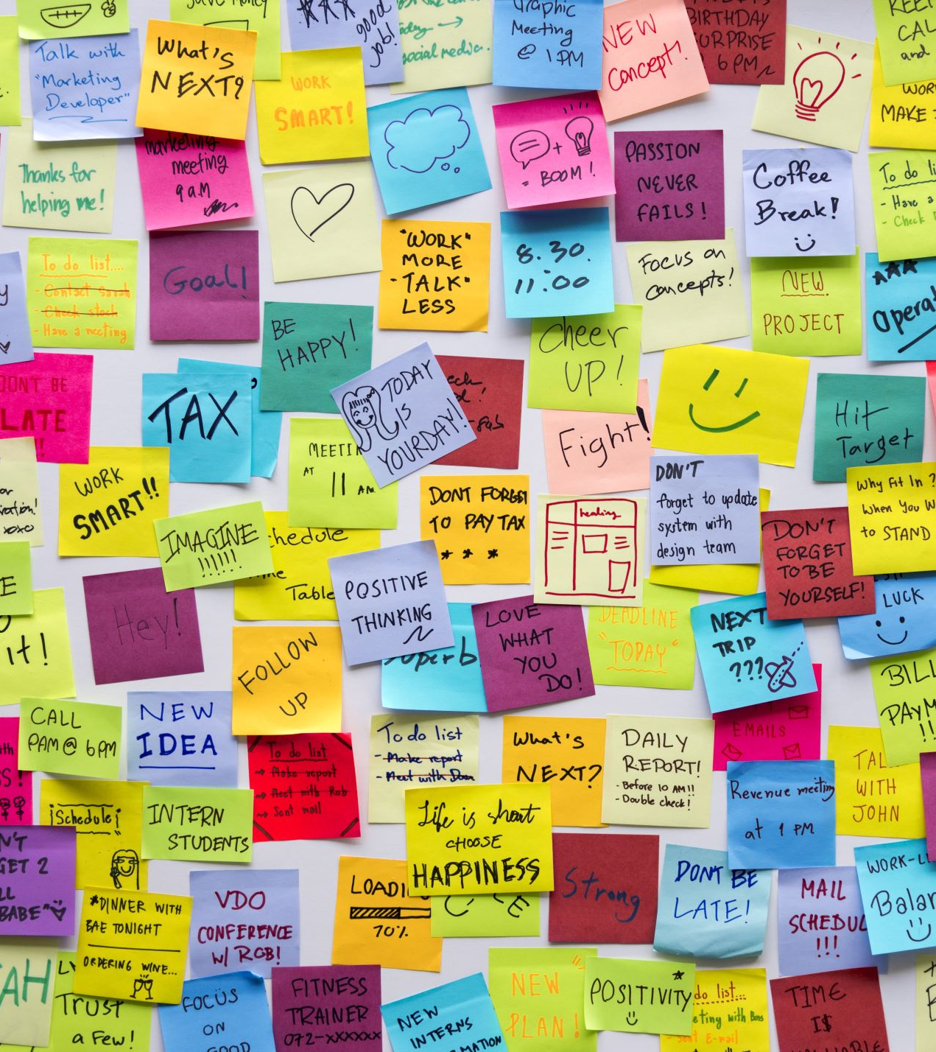
Project Idea
Goal: Help users stay productive and motivated.
Key Features:
- Add and check off tasks
- Progress bar to track task completion
- Motivational popup messages
Inspiration Sources:
- Habitica, Todoist
- GitHub task manager projects
- Python GUI tutorials

Slide 4

Development Journey
Started with a simple checklist idea.
Expanded to include progress bar and motivational popups.
Challenges: Merging multiple features into one app.
Solutions:
- Learned from GitHub examples and tutorials
- Tested each function separately

Slide 5
Live Demo
Add and complete tasks
Motivational popups appear randomly
Progress updates automatically
Save, load tasks, and set color themes
(Screen share the app live here)

Slide 6
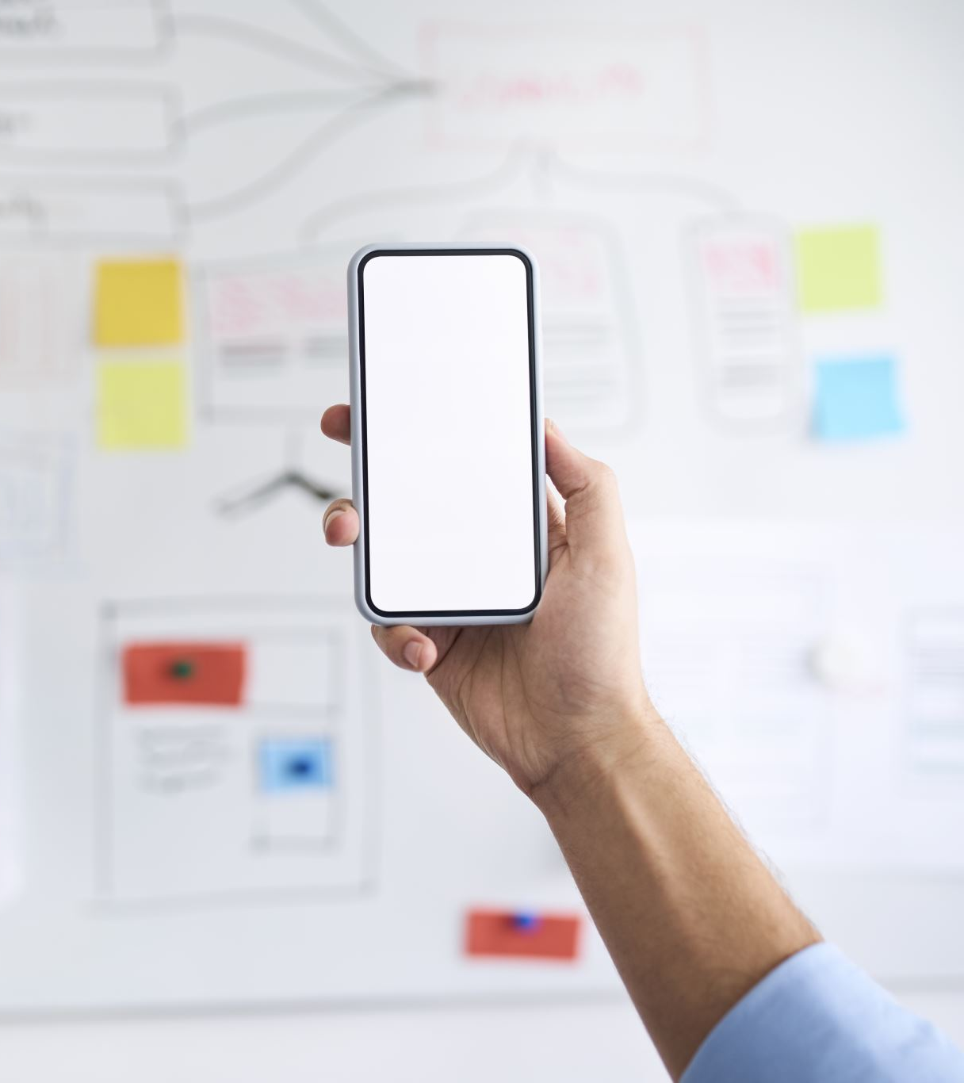
Future Enhancements
Add Recurring Tasks feature
Add Calendar View
Build a Mobile Version using Kivy or React Native

Slide 7
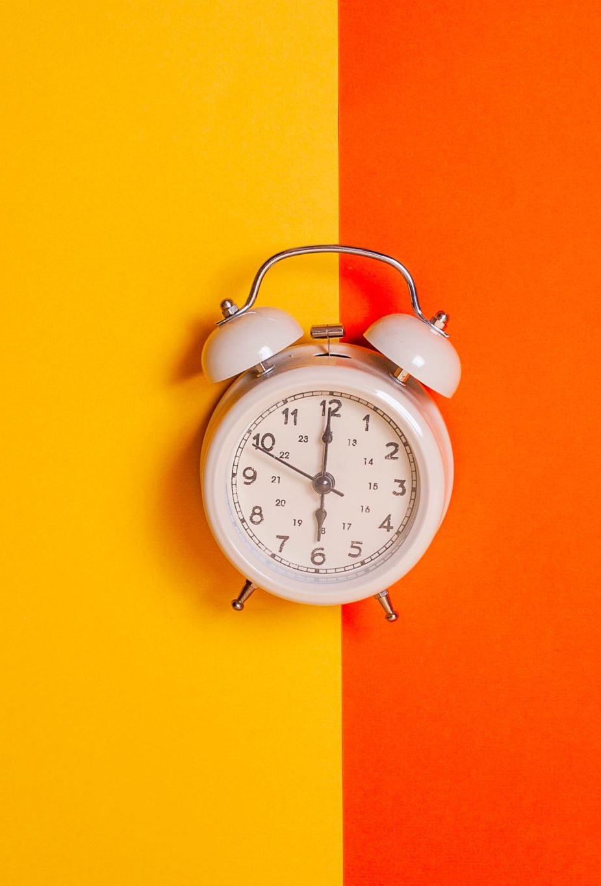
Thank you for your time!

