Slide 1
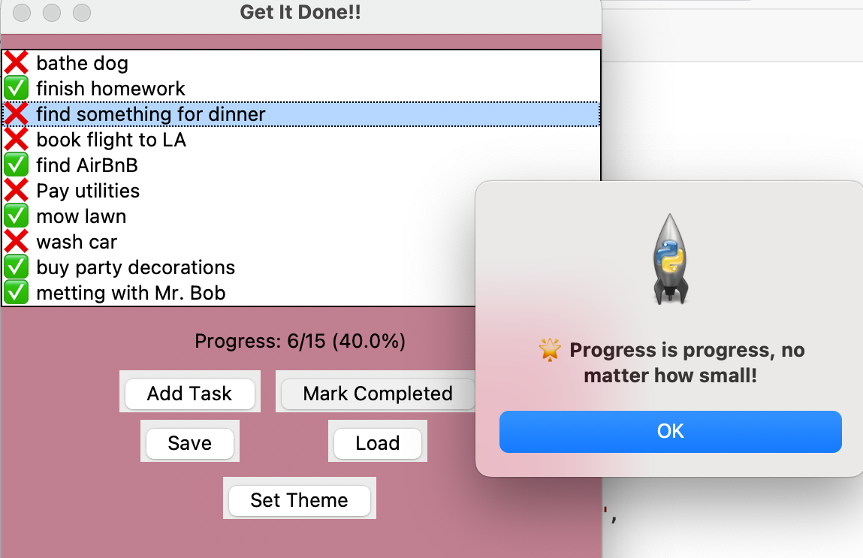
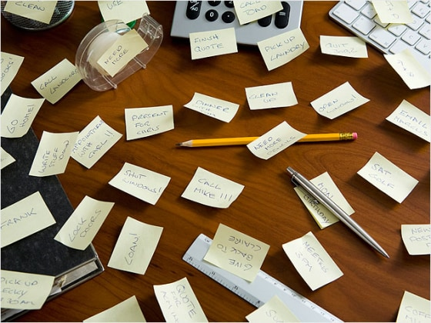
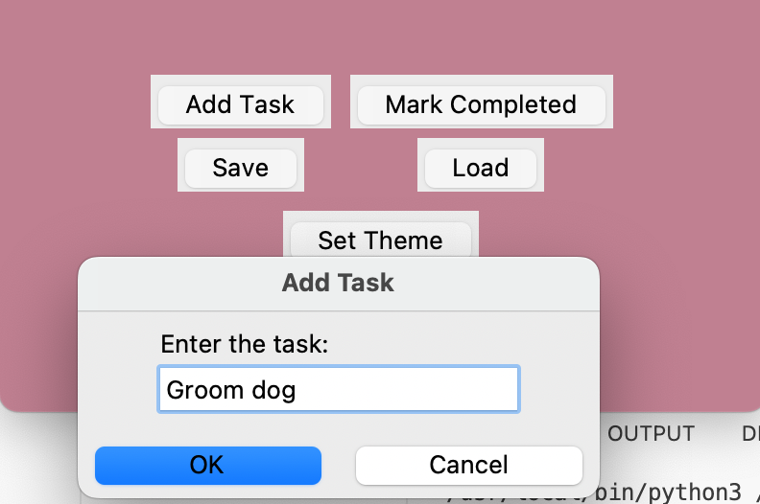
"Get It Done!! – Motivate Your Mind, Manage Your Time" (Helps users stay motivated and productive by tracking tasks and progress with encouragement.)
Brianna Jackson
https://github.com/ksu-is/Get_It_Done/tree/main

Slide 2
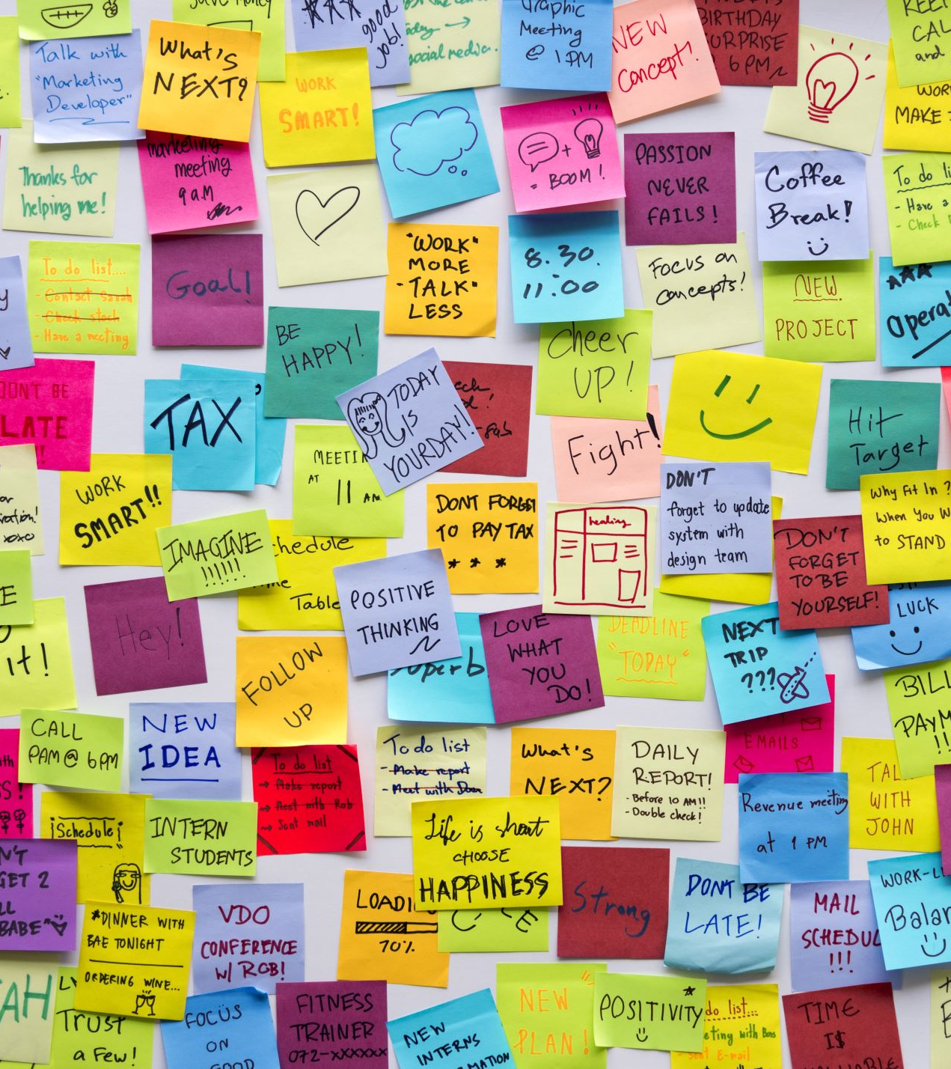
Project Idea
Goal: Help users stay productive and motivated.
Key Features:
- Add and check off tasks
- Progress bar to track task completion
- Motivational popup messages
Inspiration Sources:
- Habitica, Todoist
- GitHub task manager projects
- Python GUI tutorials

Slide 3

Development Journey
Started with a simple checklist idea.
Expanded to include progress bar and motivational popups.
Challenges: Merging multiple features into one app.
Solutions:
- Learned from GitHub examples and tutorials
- Tested each function separately

Slide 4
Live Demo
Add and complete tasks
Motivational popups appear randomly
Progress updates automatically
Save, load tasks, and set color themes
(Screen share the app live here)

Slide 5
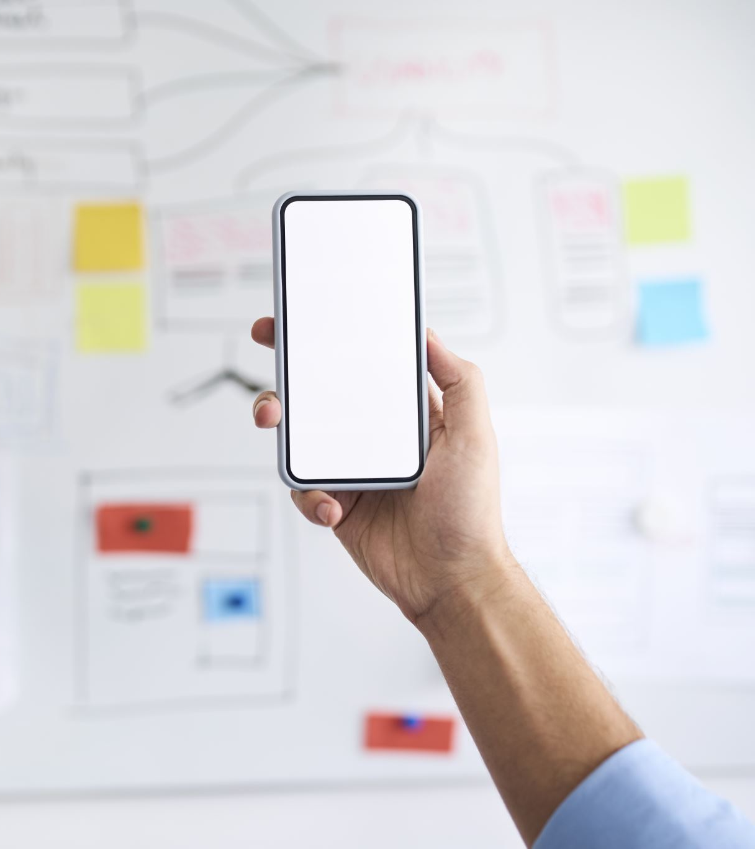
Future Enhancements
Add Recurring Tasks feature
Add Calendar View
Build a Mobile Version using Kivy or React Native

Slide 6

Thank you for your time!

