Slide 1
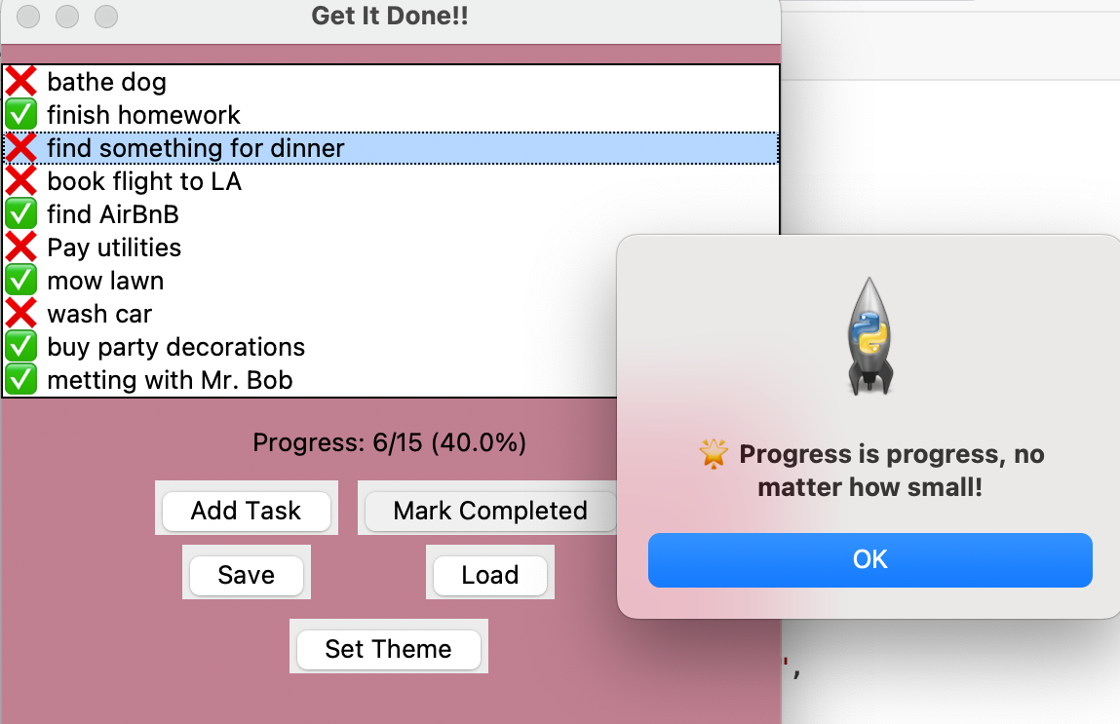
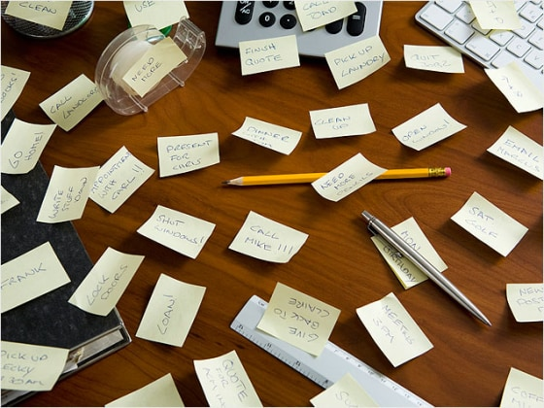
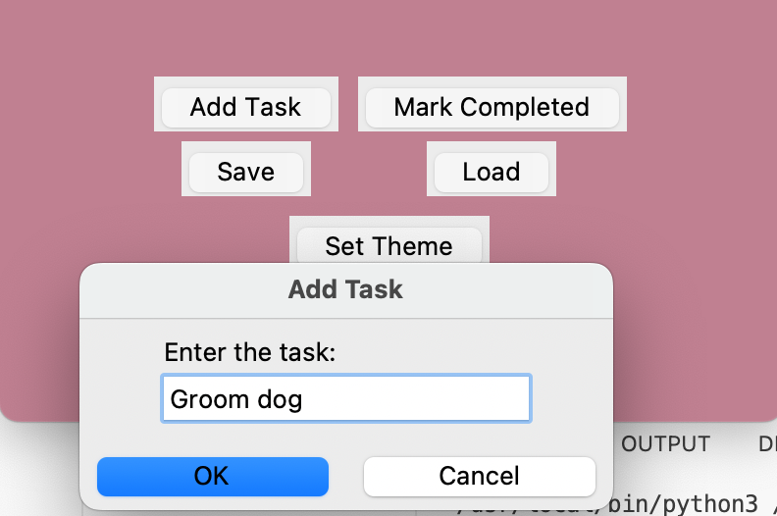
"Get It Done!! – Motivate Your Mind, Manage Your Time" (Helps users stay motivated and productive by tracking tasks and progress with encouragement.)
Brianna Jackson
https://github.com/ksu-is/Get_It_Done/tree/main

