Slide 1
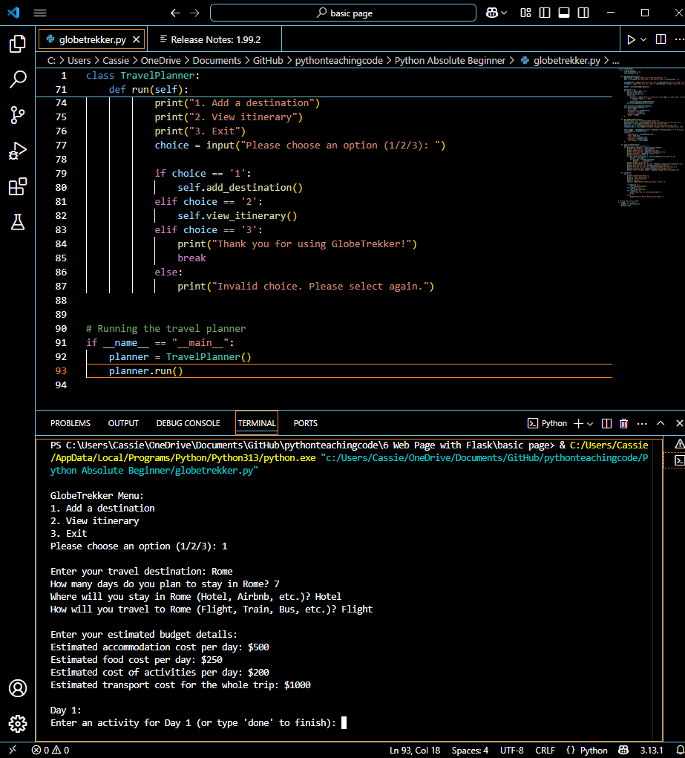
GlobeTrekker
Project by Cassie Olsen
A simple travel itinerary software to relieve the stress of trip planning.

