Slide 1
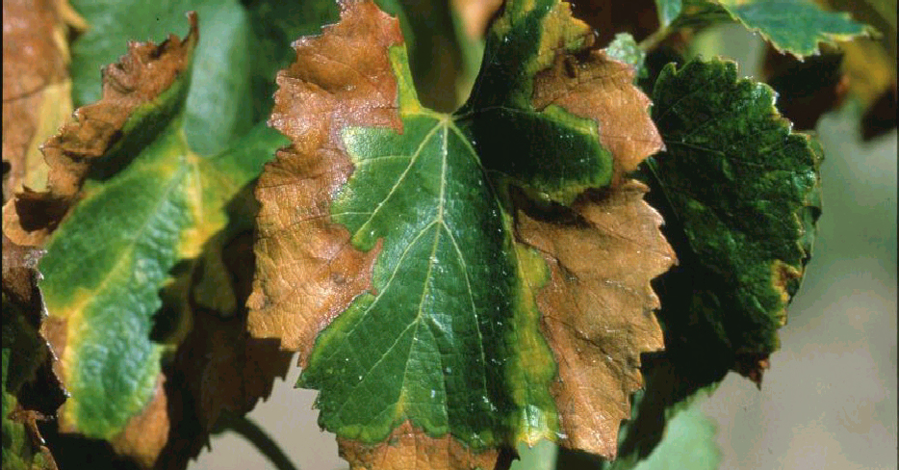
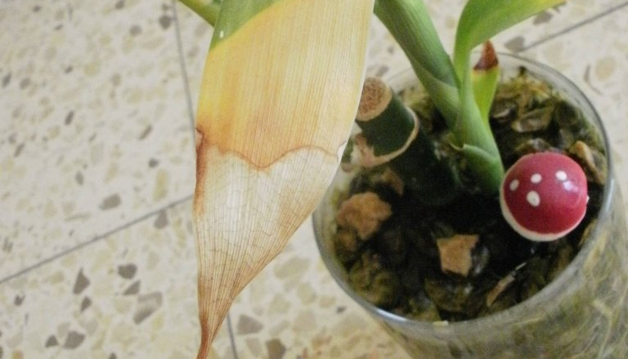
Green Doctor
An app that will let users know what is killing their houseplants
By Brenda Arrowood
https://github.com/ksu-is/Green-Doctor

