Slide 1

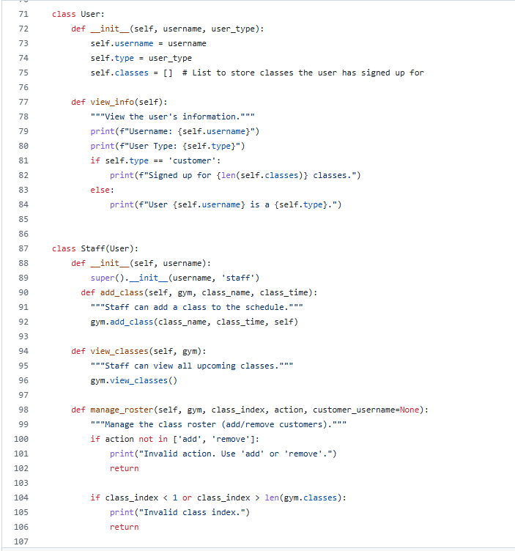
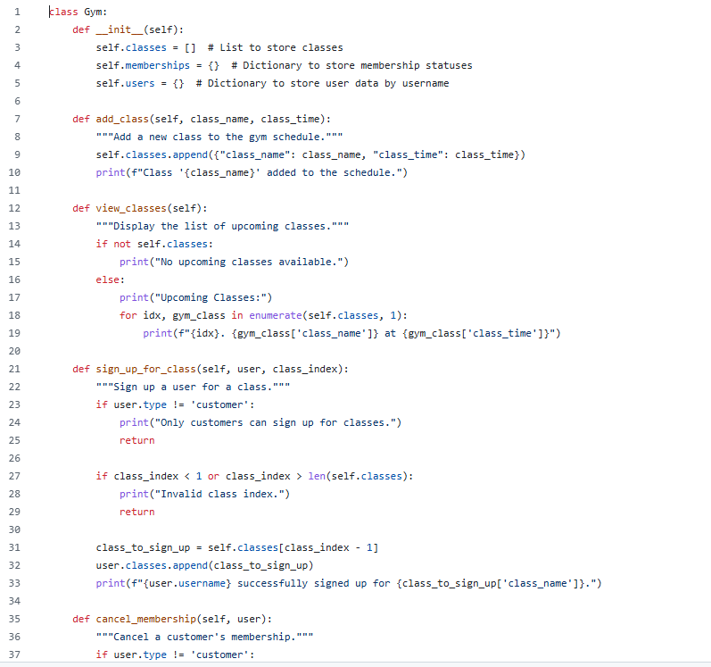
Gym Manager Pro
Project by : Adam Chappell
Making it easier for you to manage your small business

