Slide 1
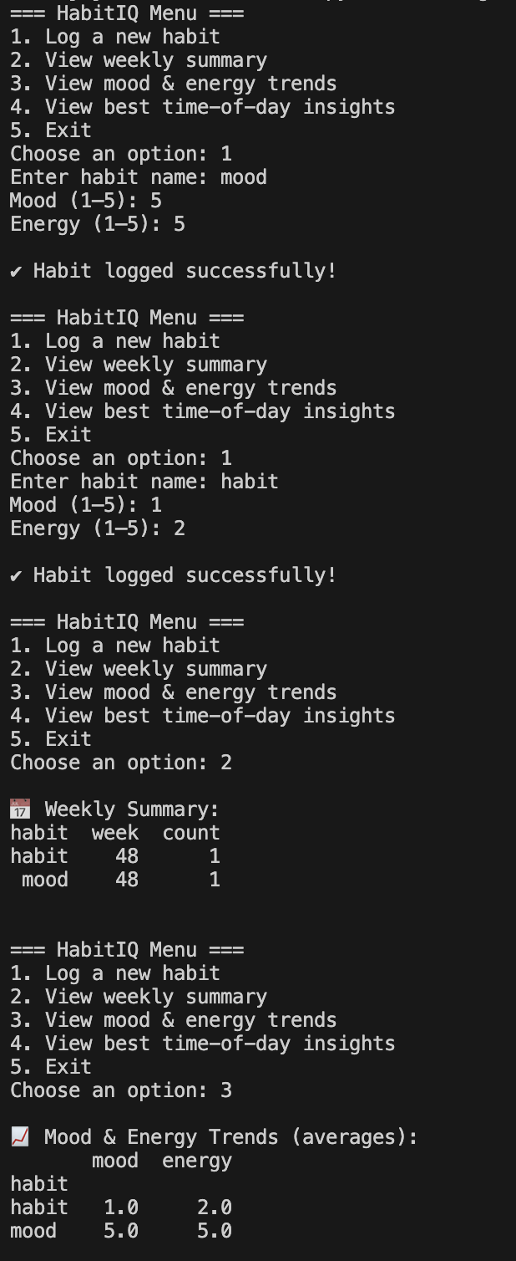
HabitIQ
See Your Patterns. Shape your future
Created by: Jordan Dorsey

