Slide 1

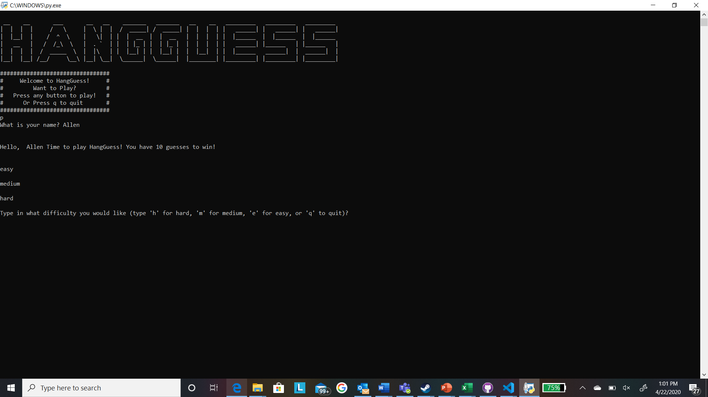
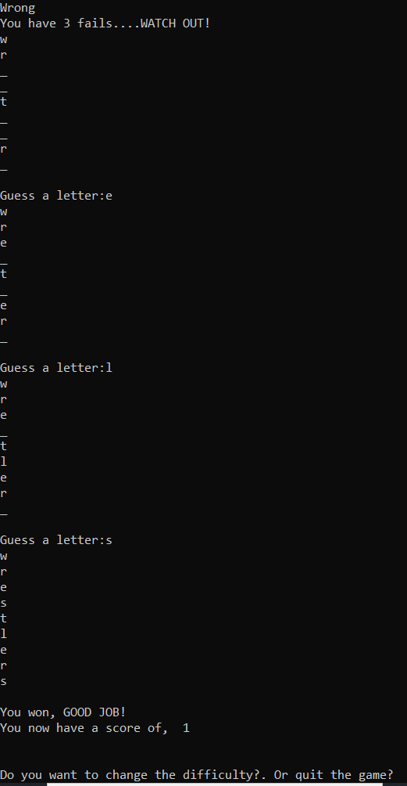
Hang-Guess
By: Hunter Giles & Alec Lombardi
Hang-Guess takes us back to a simple and fun game we have all played. Hang-guess is quite like Hang-man in which you start a game, choose a difficulty and have ten attempts to correctly guess each letter in the randomly generated word.

