Slide 1
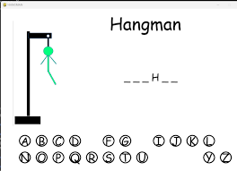
Hangtime-Havoc
Project team members: Saniya Jackson
Tagline: Classic Hangman: A game of wits, where letters can be deadly.
The screenshot I’ve provided is the outline of what I plan to use as far as imagery for the basis of my hangman game. There will be a hangman, an option to pick letters from A-Z and depending on if the player picks right body parts will be added until the player loses or wins the game.
GitHub Repository

