Slide 1
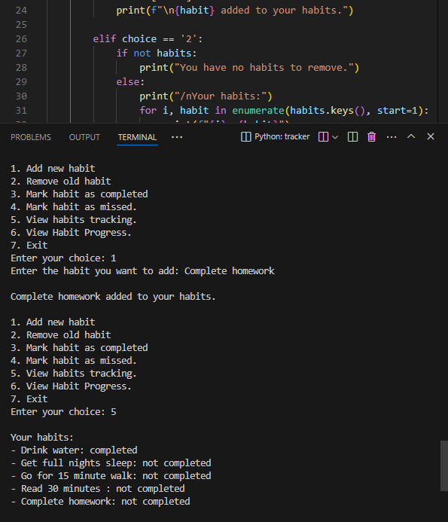
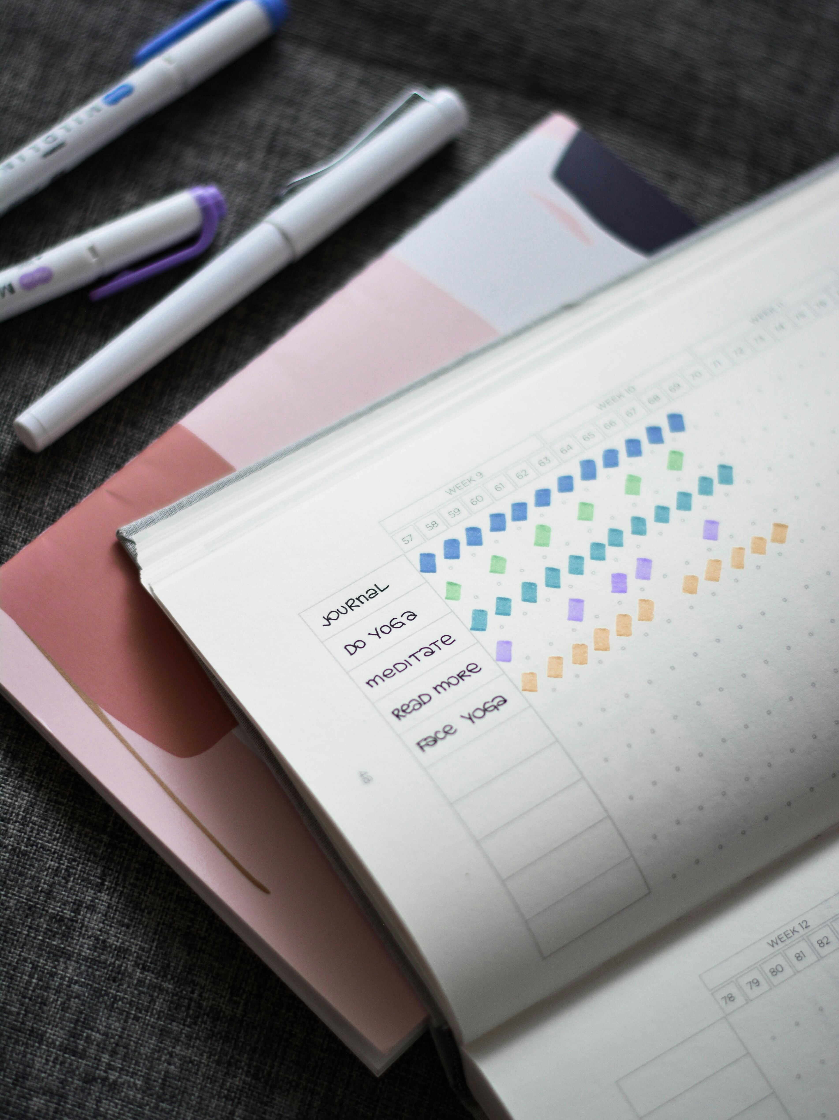
Happy Habits Builder
A python program designed to build and encourage healthy and happy habits.
Presentation by:
Emily McNair

