Slide 1
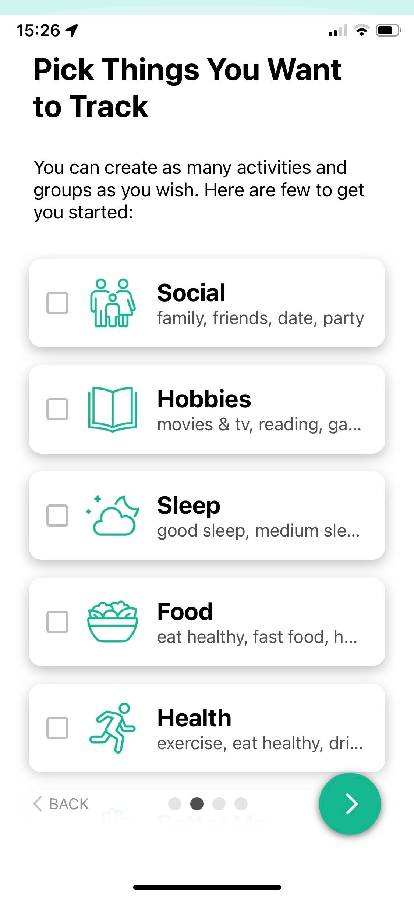
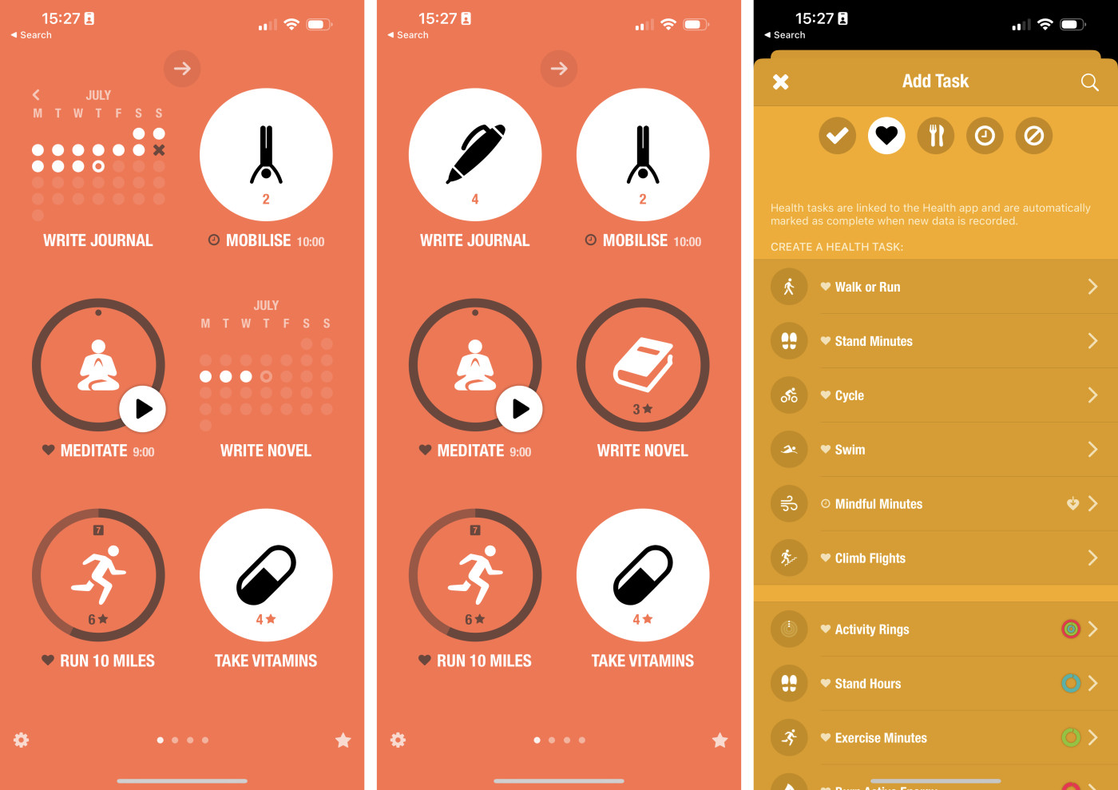
HealthHobby
Frank Umeano
Are you a gym lover?
Or
Love tracking your workouts?
Or
Need help with Nutrition
You need the HealthHobby System.
Features:
Personal Health Dashboard, Personalized Workout plans, Health Analytics.
Repository: https://github.com/ksu-is/HealthHobby

Slide 2
What was the idea?
My goal was to create a workout/ health and management system that help improve people physical and mental being.
What source code/tutorials did you find?
I found multiple tutorials on youtube and different respositories.
What source code/tutorials did you find?
The idea began with the need to track and manage workouts effectively. The primary goal was to create a simple command-line application where users could add, view, and delete workouts.
Initial brainstorming led to the identification of essential features: adding a workout, viewing a list of workouts, and deleting a workout. This simple feature set was chosen to ensure the project was manageable and useful.

Slide 3
What surprised you?
What surprised you? How did the scope change? Why? • What roadblocks did you face? How did you overcome them? (show the code and changes you made to fix it)
During the development of the Workout Manager project, a few things stood out:
Initially, the project seemed simple with just a few core features. However, as the development progressed, handling edge cases and ensuring a smooth user experience added complexity.
The importance of error handling and user feedback became more apparent than initially anticipated.

Slide 4
Run It /show the code?
Yes it runs

Slide 5
Thoughts and What’s next

