Slide 1

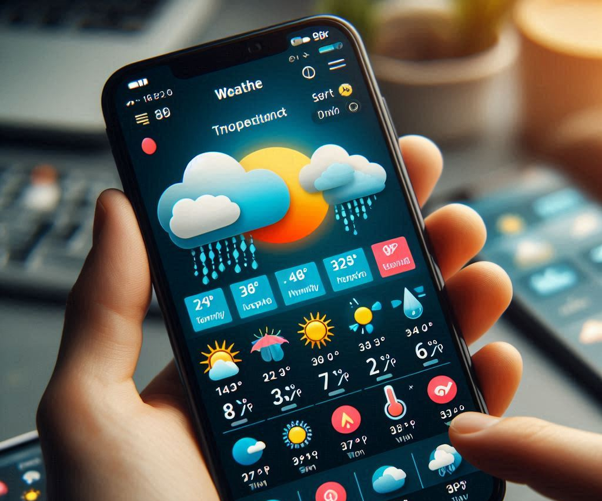
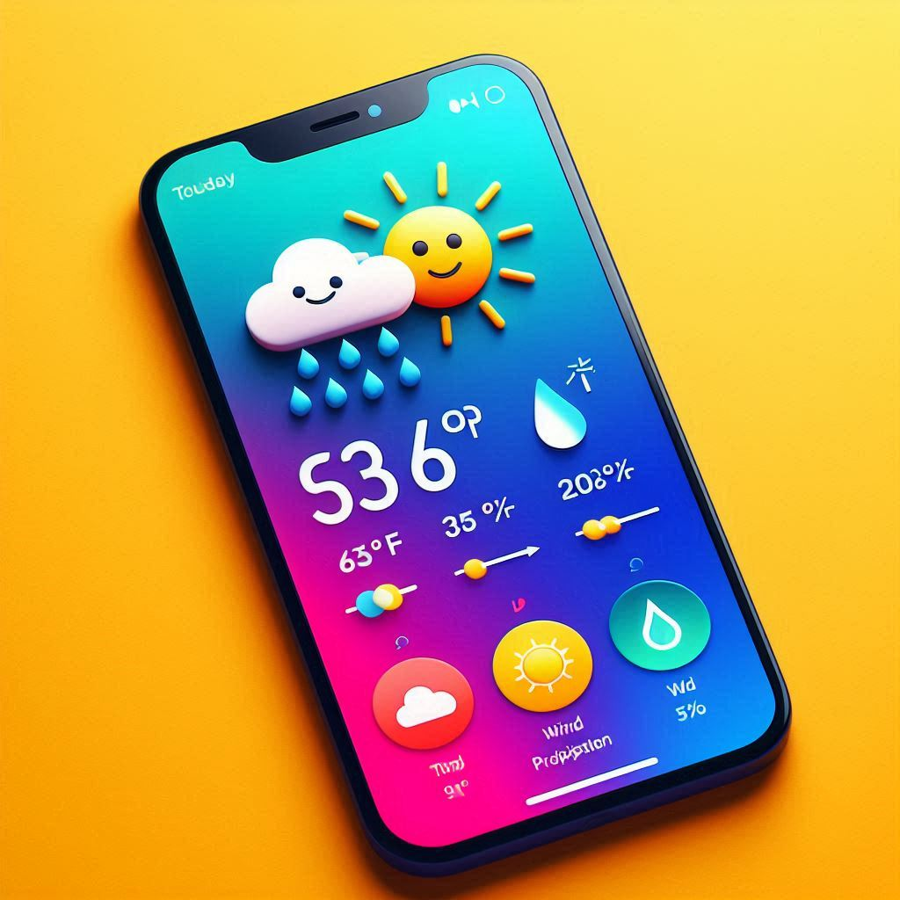


Hello_Weather by: Vanessa Aguirre
Have you ever wondered what the weather will be like tomorrow?
Have you ever wondered what is the current temperature?
I have created an app where you will enter your city that your currently in or even a city you will be traveling to soon and it will give you all the details you need to know about.
Here is my direct link to my repository https://github.com/ksu-is/Hello-Weather.git

