Slide 1

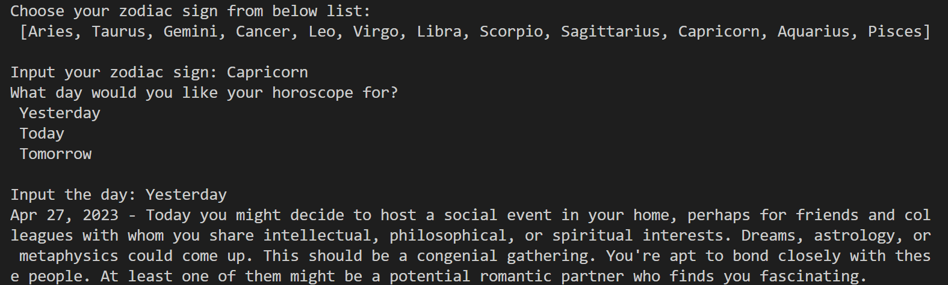
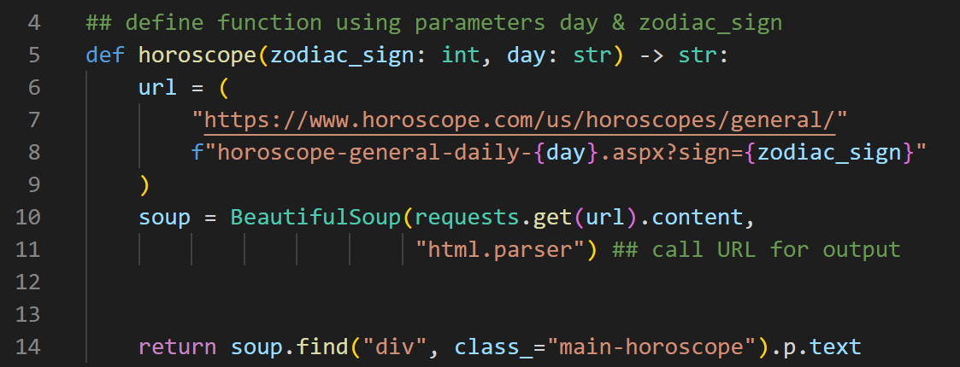
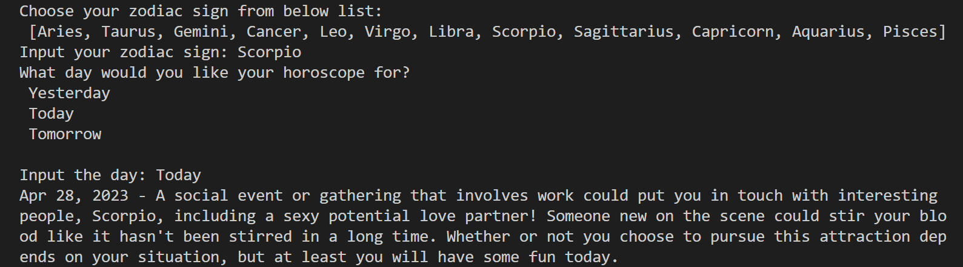

Horoscope Generator
Project completed by Kylee Gipson for IS 3020
Defining the function
Example Outputs
https://github.com/ksu-is/Horoscope_Generator

