Slide 1

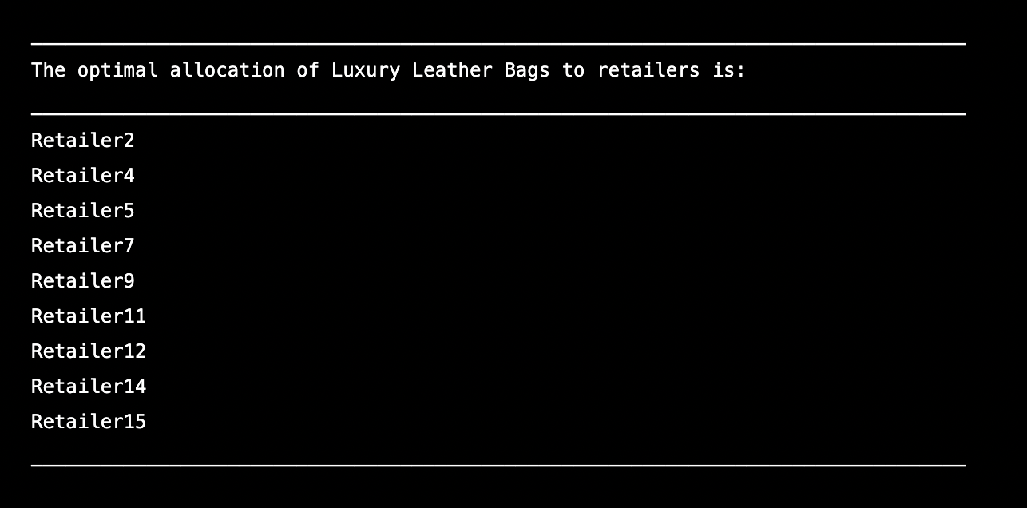
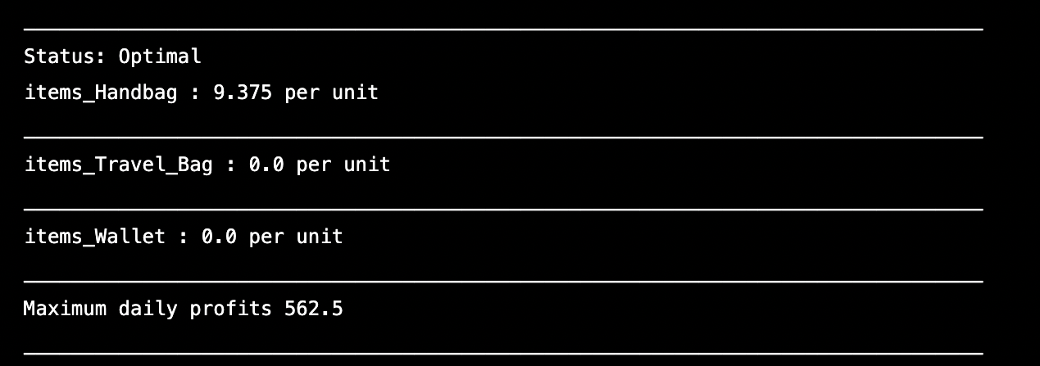
IndustryOP Project Coder: Brittany Benton
Optimize Your Bottom Line!

