Slide 1
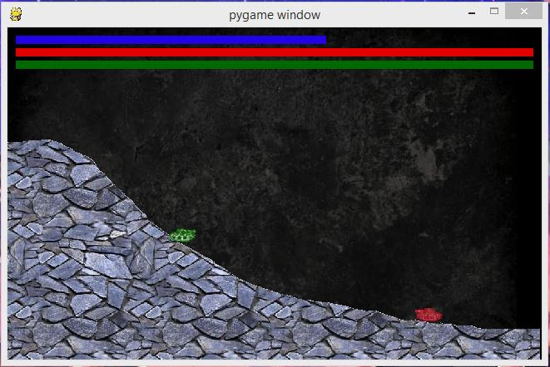
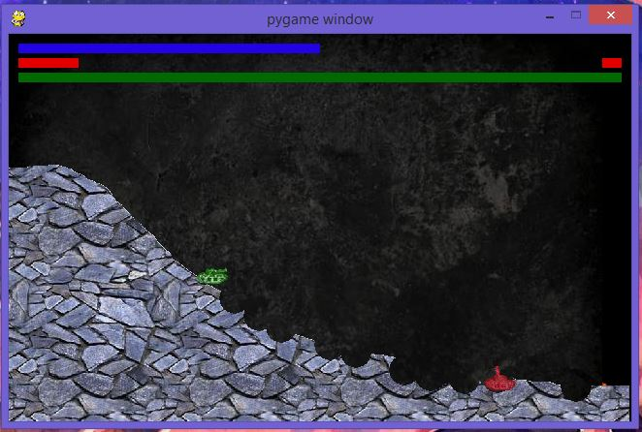
JMTank
Simple tank game with destructible terrain with customizations added
Sources:
https://github.com/kovzol/tank
https://www.youtube.com/channel/UCJbPGzawDH1njbqV-D5HqKw
Power
By: Jean-Michael Hilliard
Enemy Health
Player Health
Destructible Terrain
Player
Enemy

