Slide 1
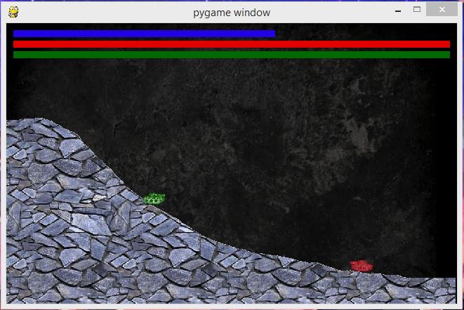
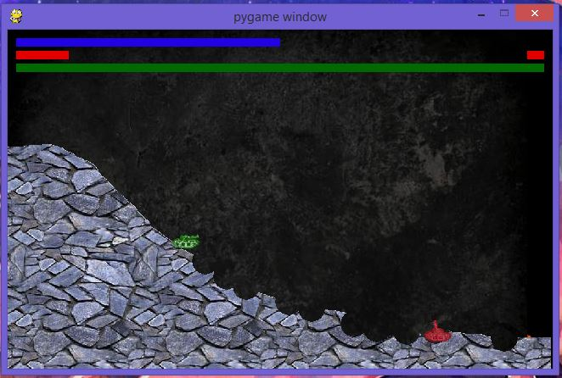
JMTank
Power
By: Jean-Michael Hilliard
Enemy Health
Player Health
Destructible Terrain
Player
Enemy

