Slide 1
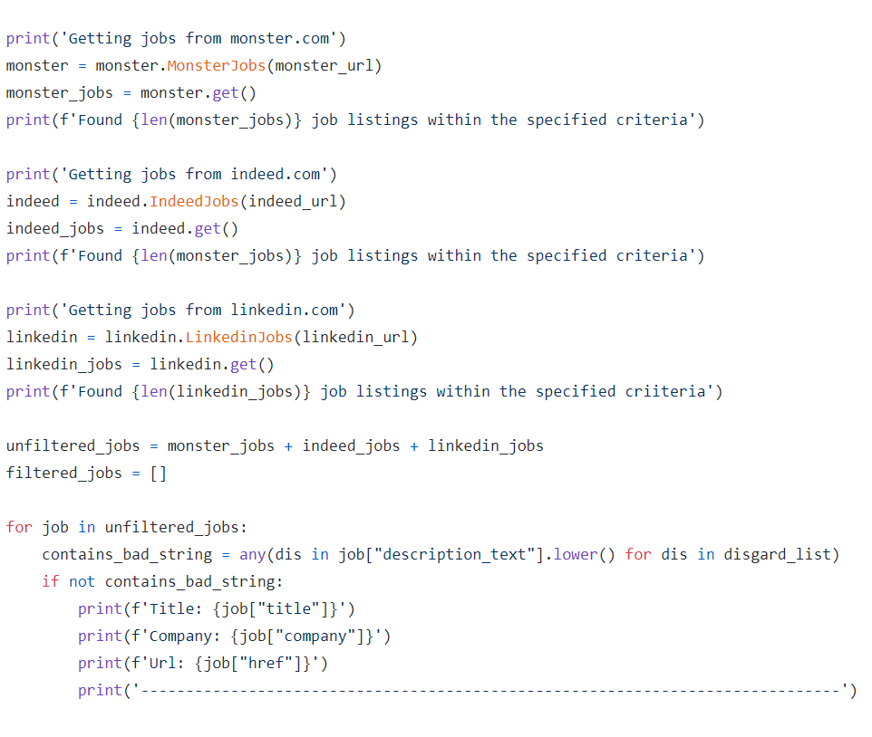

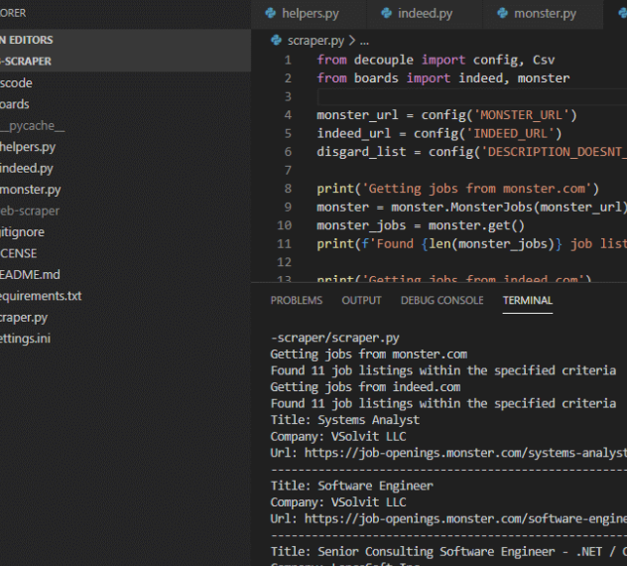
JobBot By: Maia Haile
Credit: Ermir Beqiraj
Web Scraping Tool for Indeed, Monster, and Linkedin job portals using Python
This tool is utilized by job seekers to compile lists of current available job openings on Indeed, Monster, and LinkedIn.
View code at: https://github.com/ksu-is/JobBot
Packages required:
BeautifulSoup4: a python library for navigating and querying structured documents such as HTML and XML
lxml : powerful and fast library for parsing XML and HTML
requests: for downloading web content.

