Slide 1
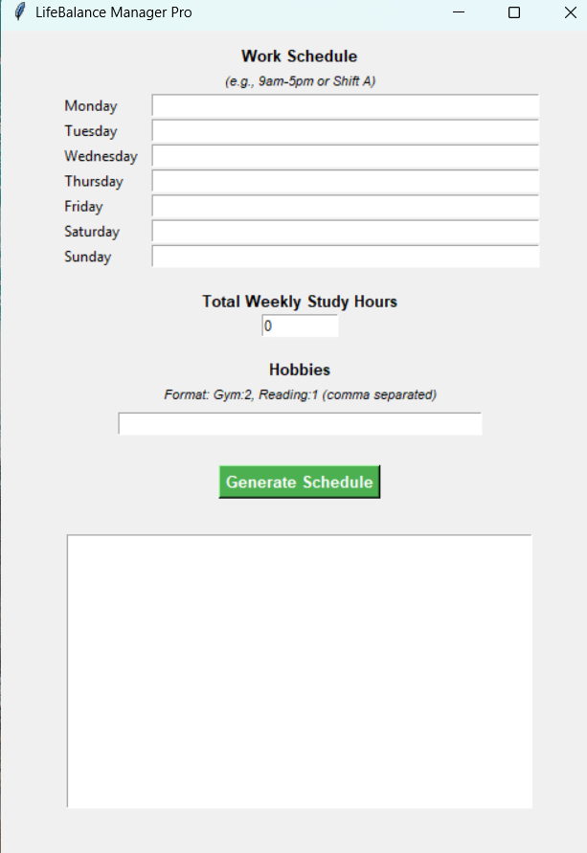
LifeBalance Manager
By Sean Loubser
Balancing work, school, and life—without the burnout.
An app that builds a realistic weekly schedule by balancing work, study time, and personal hobbies.

