Slide 1

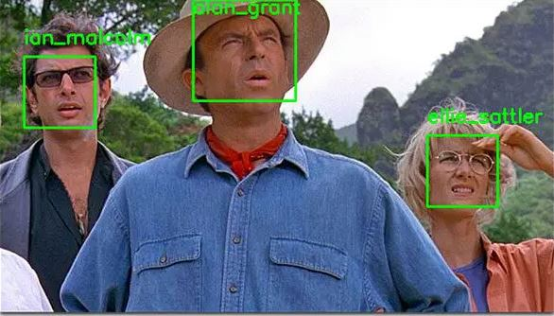

FaceVault
Introducing our powerful facial recognition software that builds a local database for unparalleled accuracy in identity verification. Say goodbye to the hassle of manual record-keeping and enjoy seamless authentication with just a glance.
https://github.com/ksu-is/Local-Data-Facial-Recognition
Face Scrape
AI
Camera
Matching
OpenCV
FaceVault
Data
Robert Darcy

