Slide 1
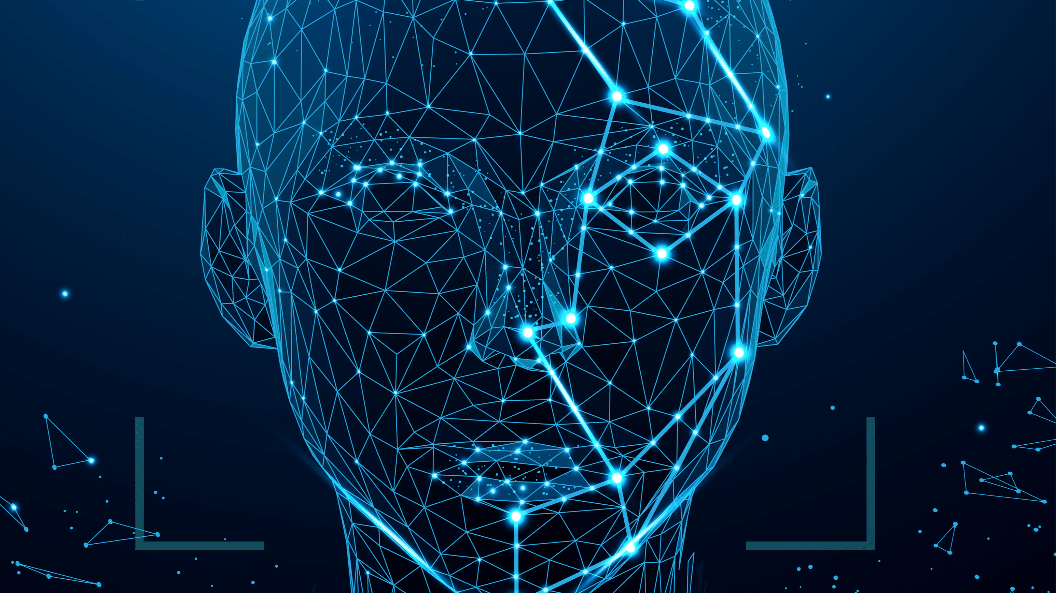
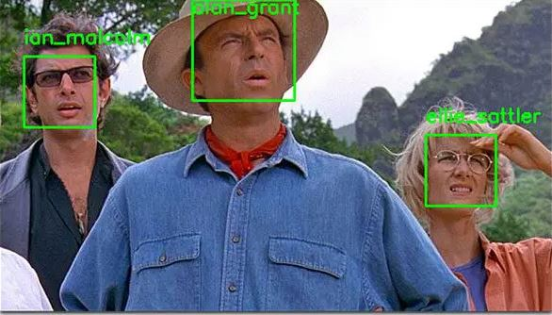

FaceVault
Introducing our powerful facial recognition software that builds a local database for unparalleled accuracy in identity verification. Say goodbye to the hassle of manual record-keeping and enjoy seamless authentication with just a glance.
https://github.com/ksu-is/Local-Data-Facial-Recognition
Face Scrape
AI
Camera
Matching
OpenCV
FaceVault
Data
Robert Darcy

Slide 2
What was the Idea?
Detect
Save
Store Data
Recall

Slide 3
Sources
Github
https://github.com/Mjrovai/OpenCV-Face-Recognition
https://github.com/davidsandberg/facenet
Websites
https://realpython.com/face-detection-in-python-using-a-webcam/
https://www.geeksforgeeks.org/detect-the-rgb-color-from-a-webcam-using-python-opencv/#
https://www.digitalocean.com/community/tutorials/how-to-detect-and-extract-faces-from-an-image-with-opencv-and-python

Slide 4
What surprised you?
Difficulty.
How many algorithms there are.
Scope changed many times.
Self expectation.
Excitement.

Slide 5
Roadblocks
Broken Code.
Packages failing to function.
Memory Leaks.
Poor optimization.
Haar Cascade needs to much training.

Slide 6
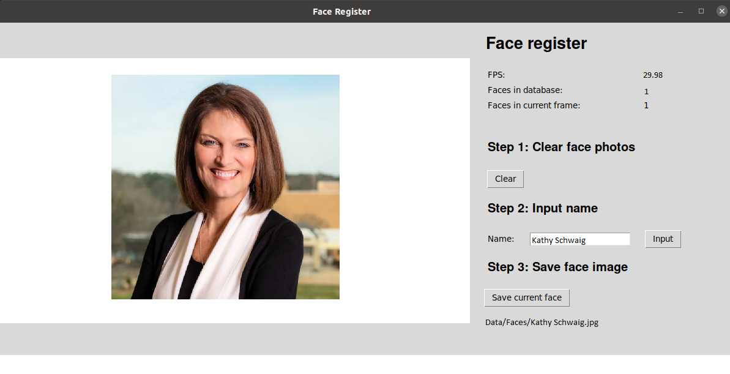
Tkinter Face Registry

Slide 7
Data
This is where it would store the picture data for some deep learning.
It would get used to organize multiple different pictures.
Picture size, Location in frame, ect.

Slide 8
Face Scrape
At first was trying to get this to automatically save my pictures a .jpg and then allow me to name them.
The code dos not really function this way as well as it being a very resource demanding and hard to program.

Slide 9
Freeze (.exe)
I was able to freeze some simple code but could never get it to execute properly.
Pyinstaller

Slide 10
What would I do next?
Seek Help
Find a better combination of packages that don’t cause issues with each other.

