Slide 1
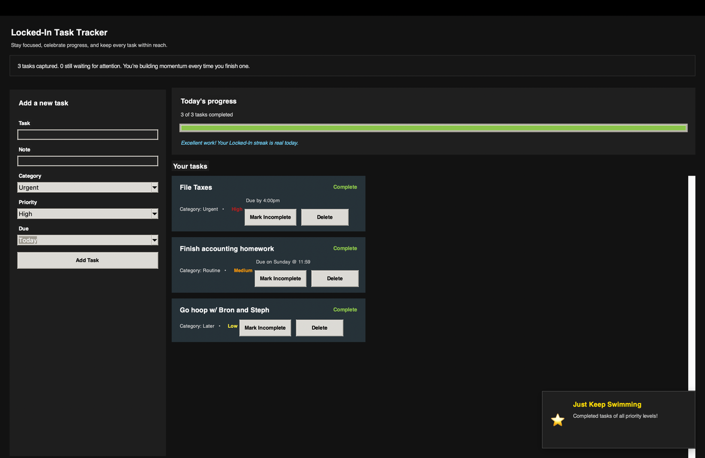




L
cked in
& Locking Procrastination Out
Missed Assignments
Procrastination
Organizes tasks and breaks them into manageable steps to make daily responsibilities easier to handle
Tracks progress and provides motivation to improve consistency through achievement system
Forgetfulness

