Slide 1
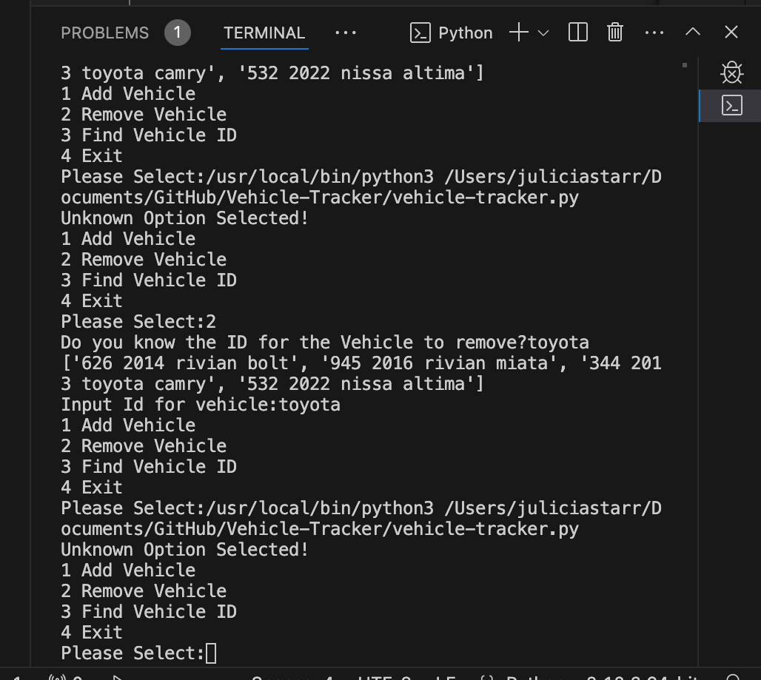

Vehicle Inventory Tracker
Our Simple Vehicle Tracker is built to maintain a continuous list of vehicle data that you can add to and remove from as needed. Making inventory tracking simple and fast!
Julicia Brown

