Slide 1
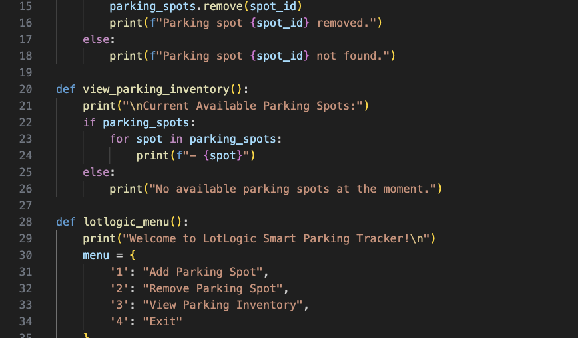
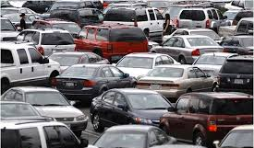
LotLogic
Helping you find parking, save time, and reduce stress.
Foundation for future integration with real-time data and mobile/web interfaces
Ideal for students, event-goers, and delivery drivers
Presented by Luis Flores

