Slide 1
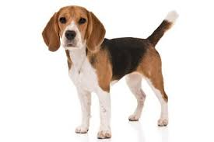
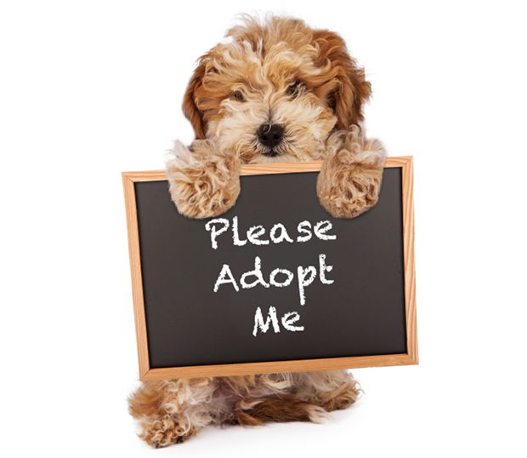
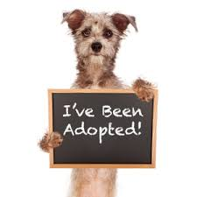

Doggy Tracks Adopt a dog today!
Project Coder:
Madison Caldwell
Attribution Coders:
Ryan Shea

