Slide 1

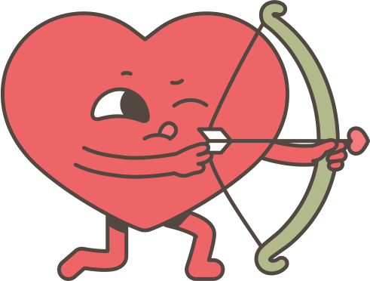

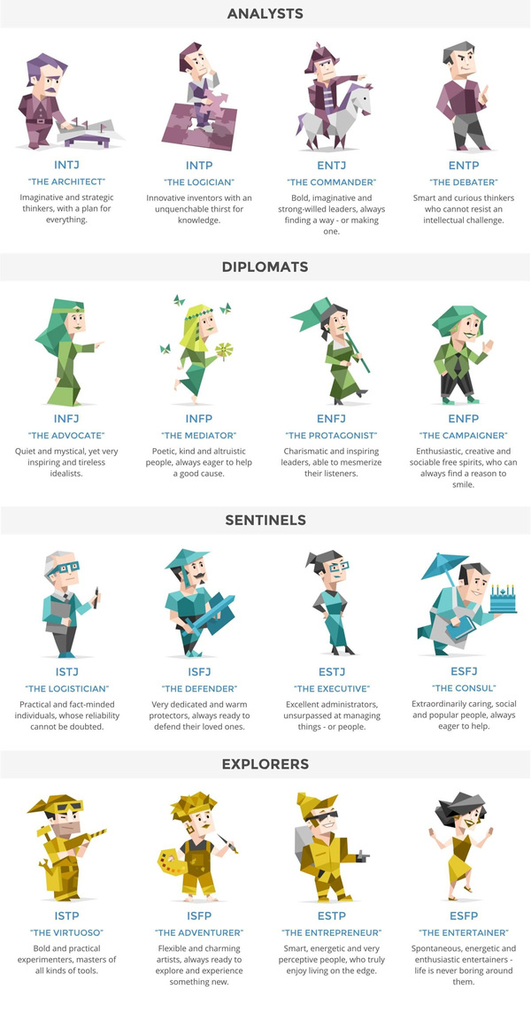
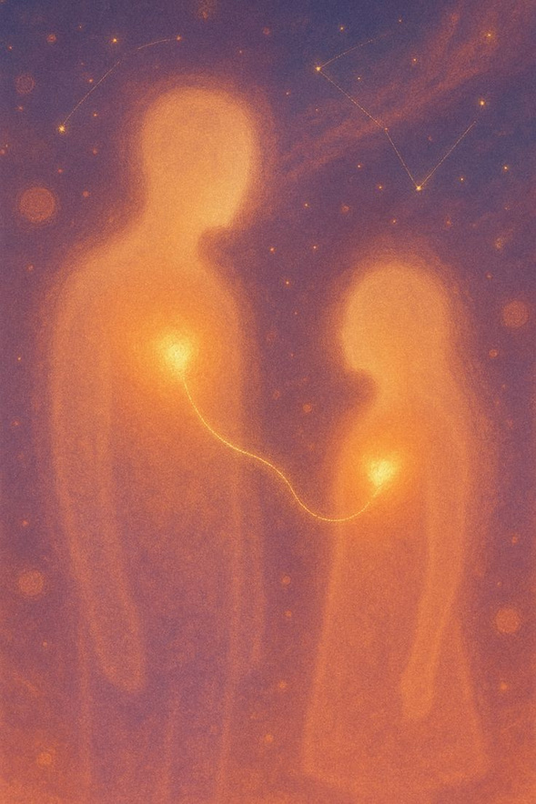
MatchBox
Personality based match-making
...based on the Meyers-Briggs 16 personality quiz
PROF. STEPHANIE SAMPLE| KIRSTYN NAVARRO | IS 3020

