Slide 1
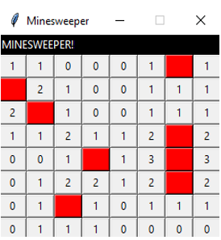
Minesweeper by Fedrice Masse
A fun game where the player attempts to avoid mines in a minefield.

