Slide 1
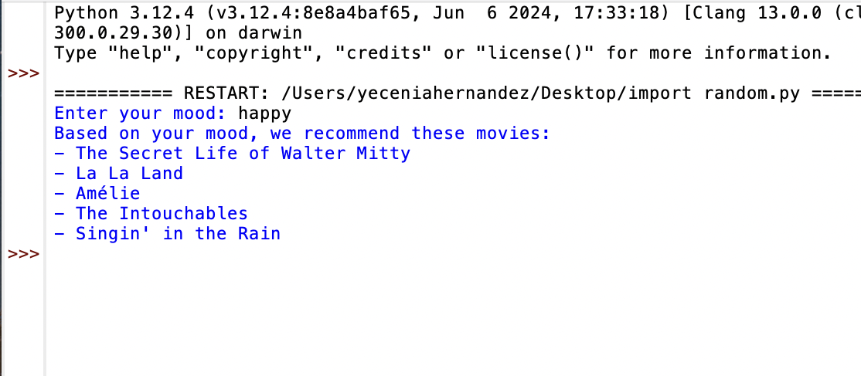
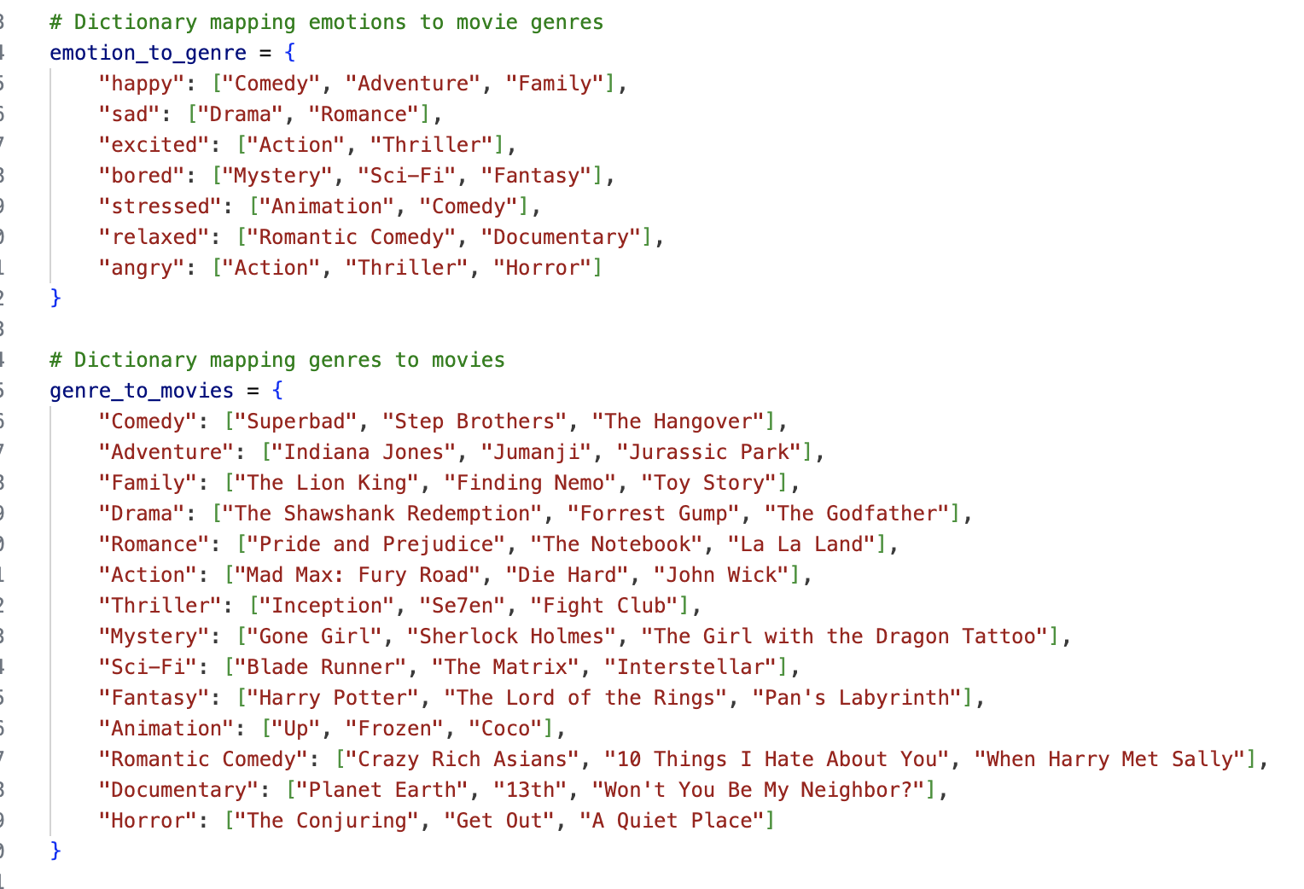
MOOD-MOVIE
Yecenia Hernandez
Mood Movie is a personalized Movie recommendation code that will require the user to input their mood and the output will be a recommendation. The recommendations are made by popular movies categorized by genres, moods, themes, and more.
https://github.com/ksu-is/Mood-Movie.git

