Slide 1

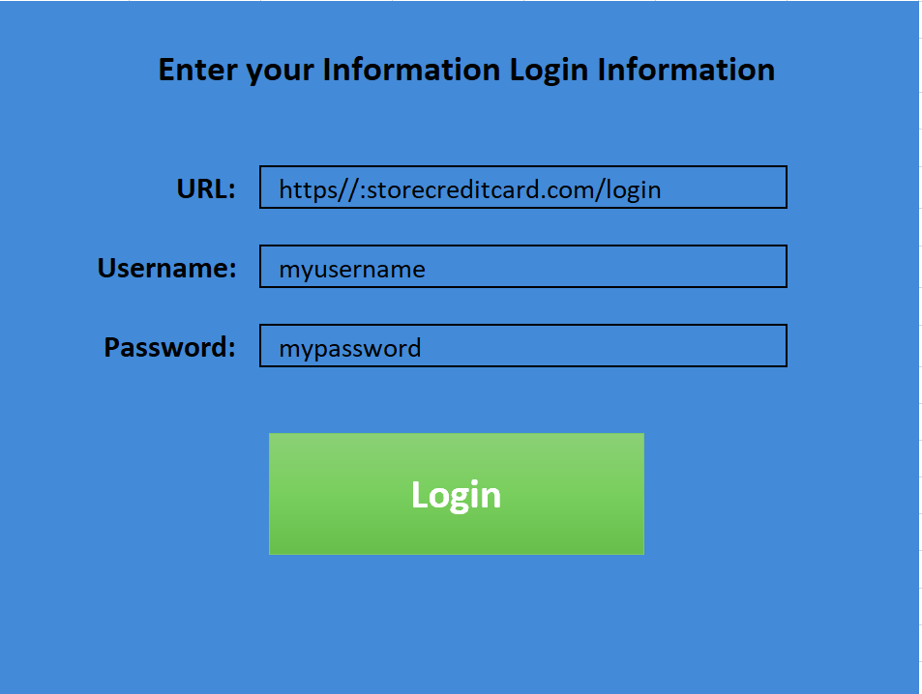
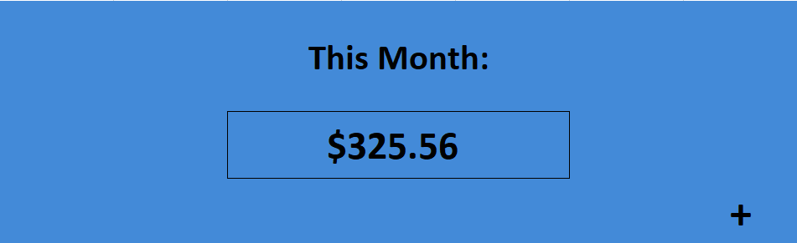
MyMonthly Payment
Collect and total users bills with the information users provide
By: Lyss Hochberger

