Slide 1
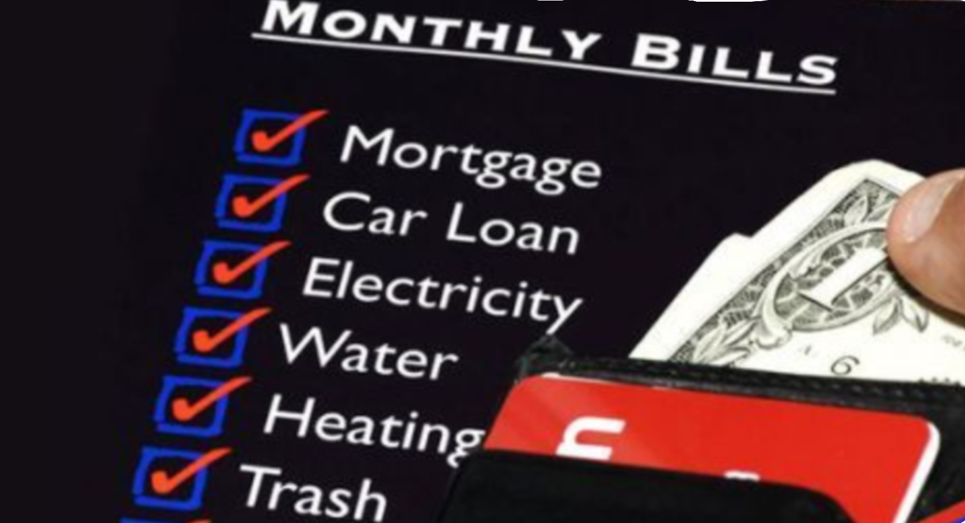
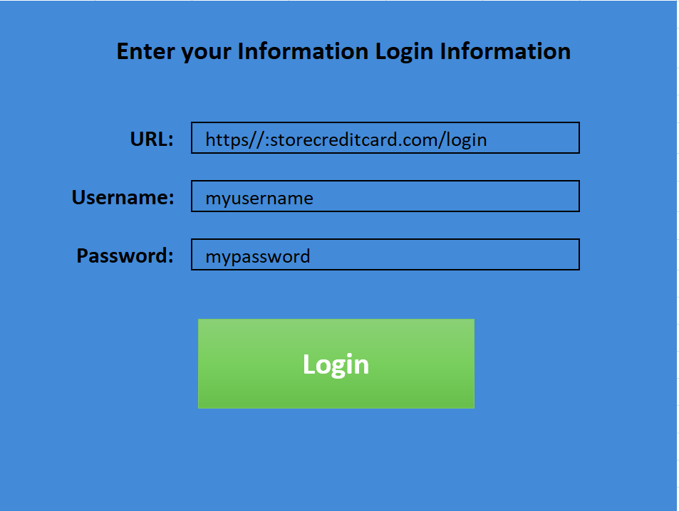
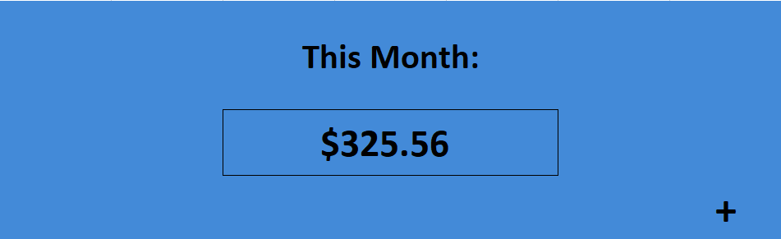
MyMonthly Payment
Be in the known of your total monthly costs in bills
By: Lyss Hochberger

