Slide 1
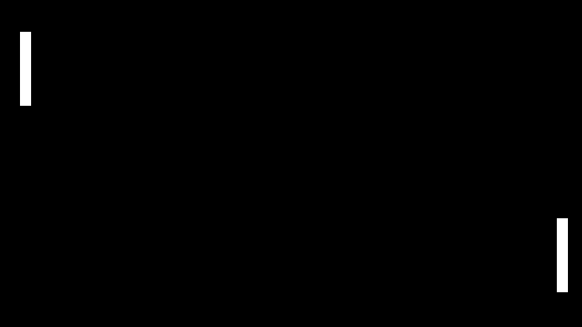
Simple Pong Game
Developed by Nathan Baker
A simple, two-player Pong game with easy to understand gameplay, physics and basic scoring mechanics

