Slide 1

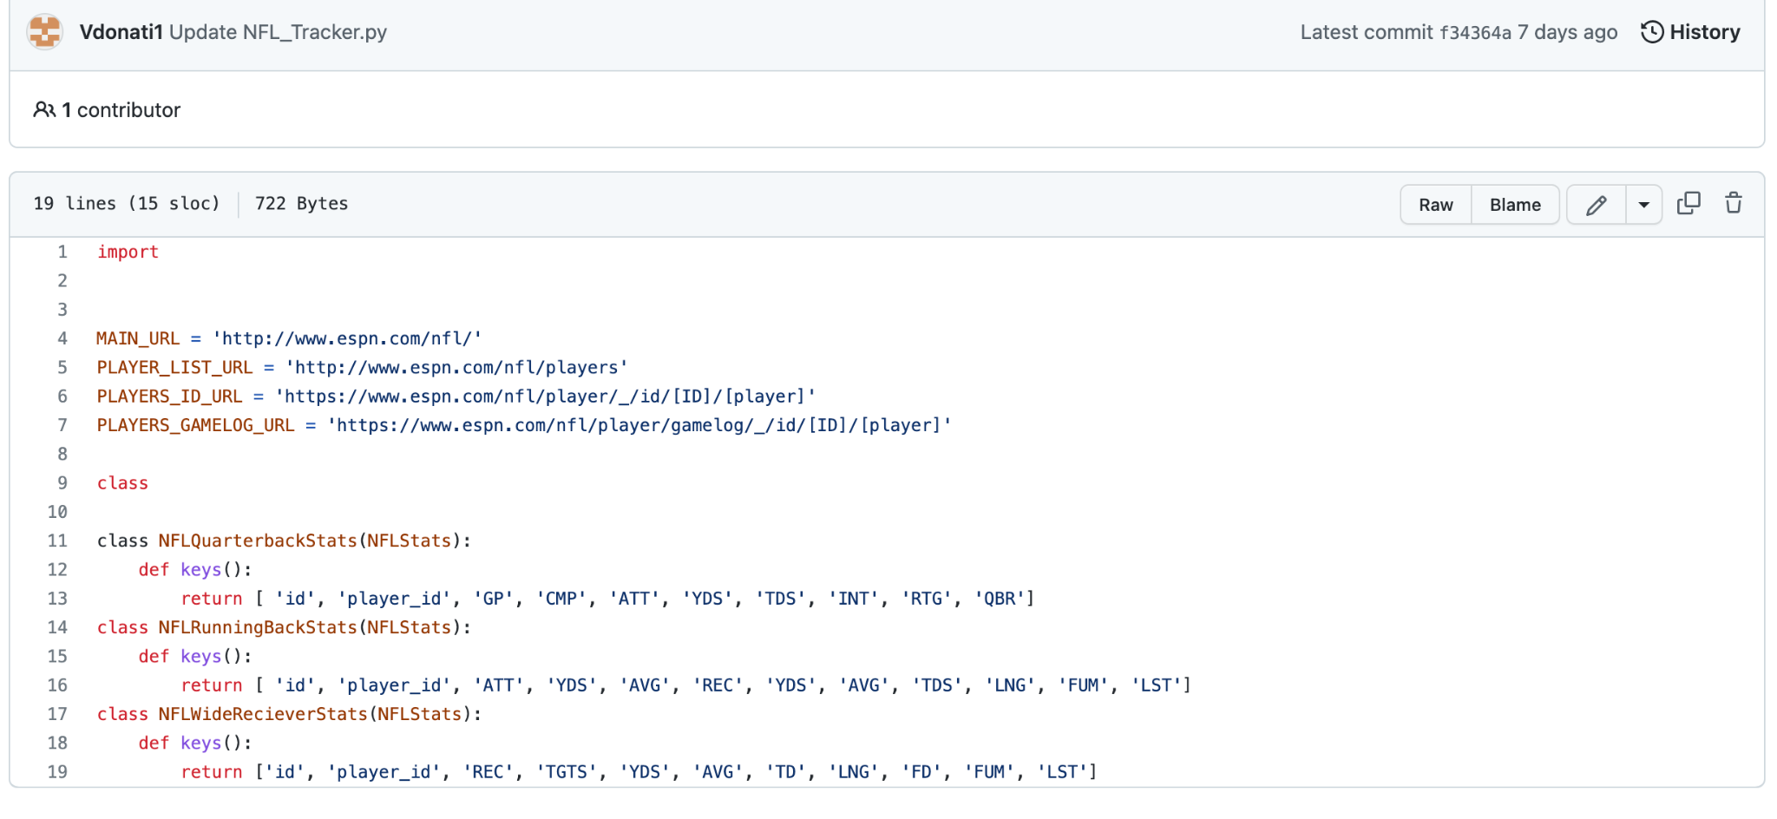
NFL-Stat Tracker
By: Vinny Donati
Coding software that keeps track of NFL stats throughout the season of every player

