Slide 1




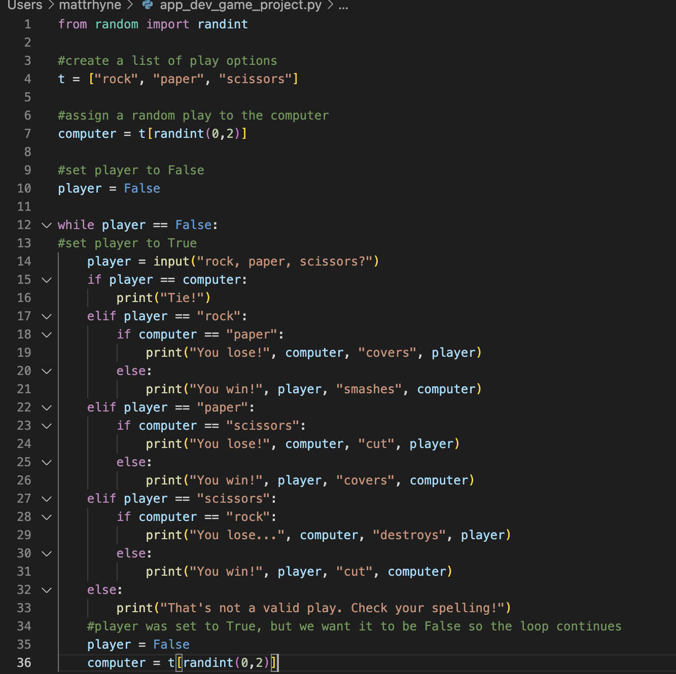

Rock, Paper, Scissors!?
Classic head-to-head game against the computer or another player with 3 simple out comes: win, lose, or draw.
https://github.com/ksu-is/rock_paper_scissors
Members: Matthew Rhyne

