Slide 1

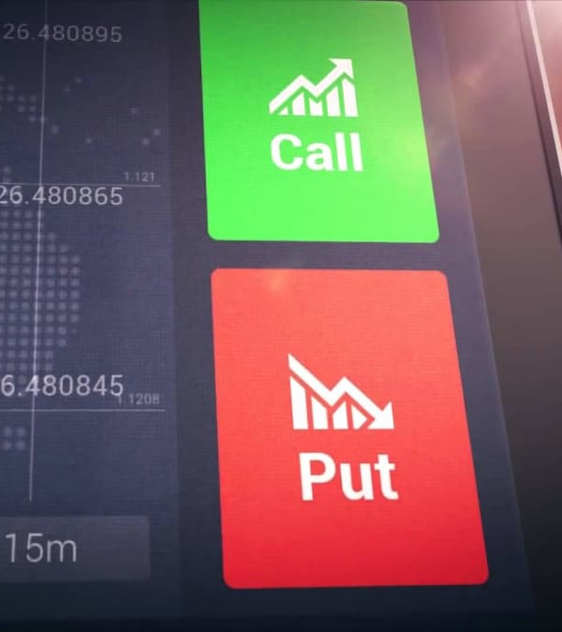

Options Calculator
Coder: Stephen Vlasoff
Using: jknaudt21 & Sincity231 Repository
Gather 100+ Pieces Of Financial Information As Well As Calculating The Fair Value Of An Option Contract In Seconds

