Slide 1
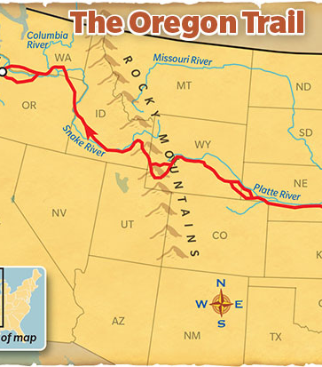
Oregon Trail Game
Want to take risks and see how good your decision-making skills are? Then you came to the right game! Press your luck and see if you have what it takes to travel the Oregon Trail.
By: Luis Delatorre
Attributions:
https://github.com/yoshino-lin/Oregon-Trail

