Slide 1
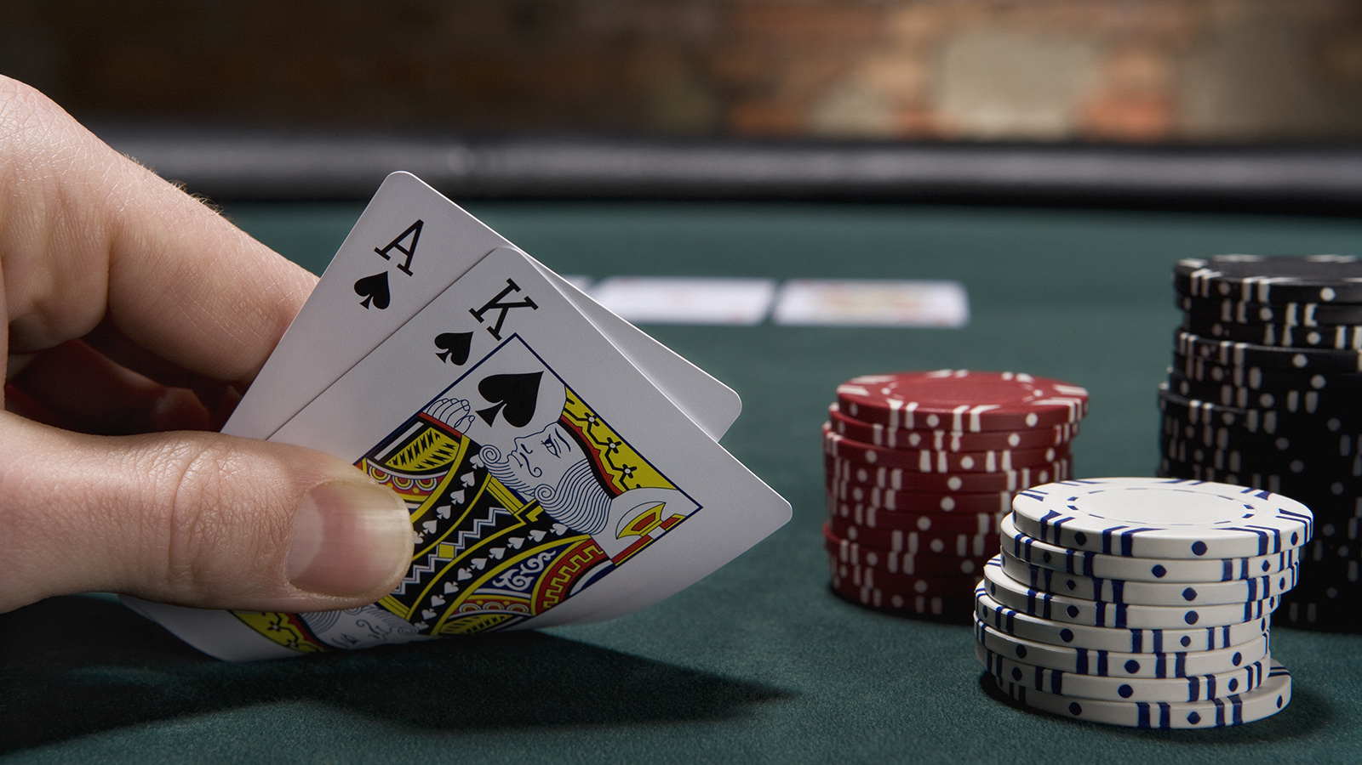
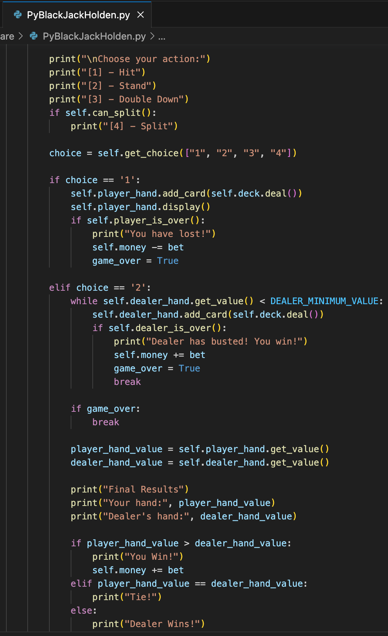
PYBlackJack
Created by Holden Bare
Bringing the casino to your console: A dynamic, interactive, and feature-rich Blackjack game in Python.

