Slide 1
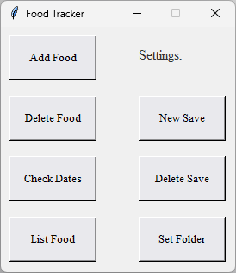
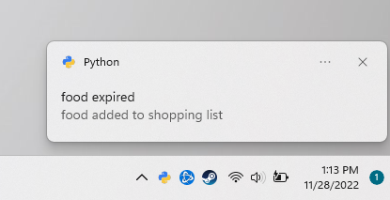
Pantry Food Tracker
David Thomas
Track your food. Auto generate your shopping lists!
https://github.com/ksu-is/Pantry-Food-Tracker

