Slide 1
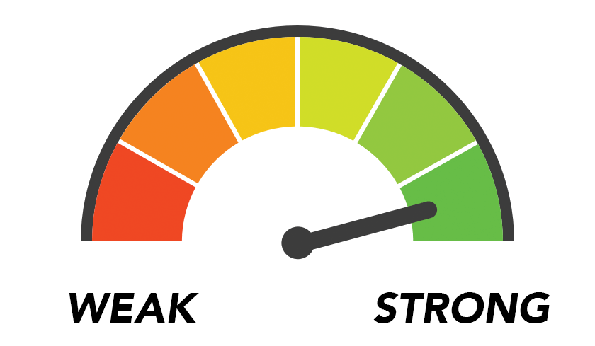
Password Strength Tester
By: Darshan Desai
GitHub URL:
https://github.com/Ddesai013/Password-Strength-Test-Fall21
A website to test the strength of your desired password!

