Slide 1

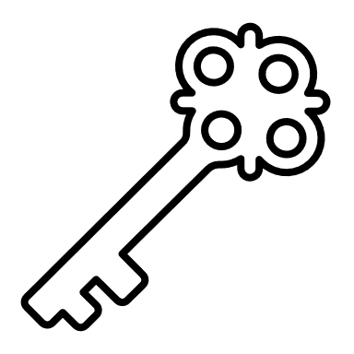


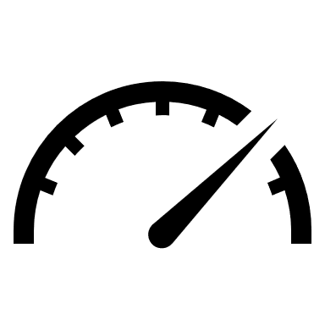



Password Strength Tester
Can your code be cracked?
A Python project by Evan Villar

